Slide 1
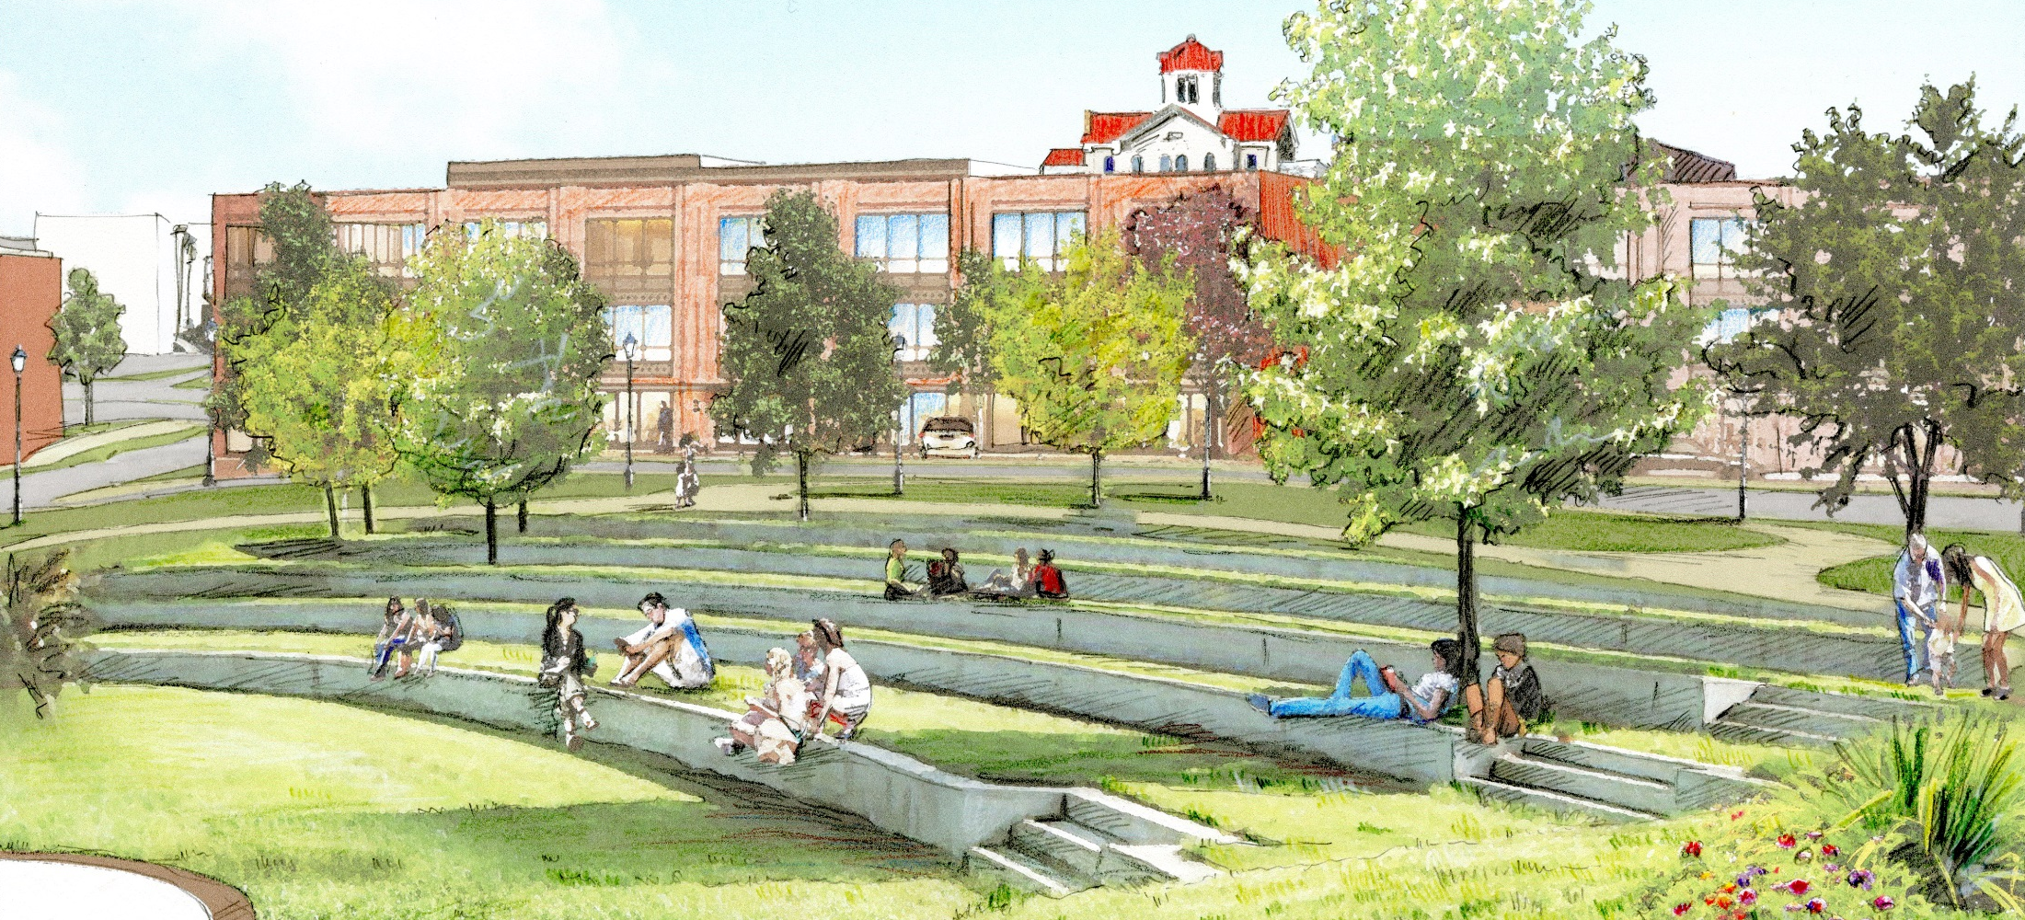
RENAISSANCE STRATEGIC VISION & PLAN

Slide 2
PLANNING PROCESS:
The Three-Step

Slide 3
Step 1: Plan Review
Takeaways:
Preserve historic recourses
Enhancing walkability, connectivity, and parking
Improve the business mix
Attract infill and housing options
To Date:
Jefferson has done a good job staying current with updates to major plans
Mixed use buildings permitted in key locations in zoning districts throughout downtown
Historic guidelines help insure that new development is complementary to existing character

Slide 4
Step 1: Demographic & Market Brief
Jefferson is wealthier, slightly older, better educated than Georgia as a whole
The city has grown over 166% since 2000 and growth will continue. Time to prepare
2015 Population Estimate: 10,195; 2025 Projected Population: 21,551
Growth slowed post-recession but will resume
The majority of citizens live in family households
Two-person households are on the rise
Home values are higher than Georgia median prices and the majority of housing stock (52.9%) has been built since 2000
Most Jefferson citizens fit solidly within the middle class, with a growing proportion of upper-middle class residents

Slide 5
Step 1: Demographic & Market Brief
Jefferson residents have a higher income than Georgia residents as a whole:
Jefferson Average Household Income: $67,217; Georgia: $47,829
Projected Jefferson Average Household Income 2021: $74,956
60.5% employed in “White Collar” Jobs (Management, Sales, Administrative Support, etc.)

Slide 6
Step 1: Market Analysis
Takeaways:
People come to town to purchase goods at:
Furniture & Home Furnishings Stores
Food & Beverage Stores (Grocery Stores, Markets)
Gasoline Stations
Motor Vehicle & Parts Dealers
100% of local consumer traffic leaves Jefferson to purchase / consume goods at:
Electronics & Appliance Stores
Beer, Wine & Liquor Stores
Shoe Stores
Jewelry, Luggage & Leather Goods Stores
Book, Periodical & Music Stores
Non-store Retailers (Mail Order Houses, Vending, Direct Selling)
Special Food Services (Catering, Delivery, Food Trucks)
Drinking Places - Alcoholic Beverages (Bars, Music Venues)

Slide 7
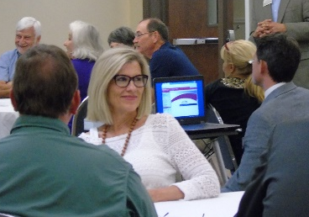
Step 1: Public input
20+ One-on-one Interviews
14 Focus Groups
Community-wide Town Hall Meeting
800+ Completed Surveys

Slide 8
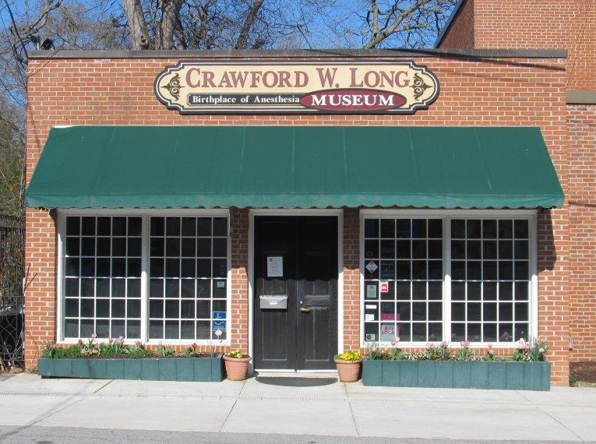
Step 1: top Hits
Historic Character
The Square & Streetscaping
Downtown Events
Small Town Atmosphere
Location & Proximity
Public School System
Local Businesses

Slide 9
Step 1: Top Issues
What Needs Improvement?
Downtown Connectivity/Walkability
Parking & Traffic
Creating a Destination/Variety
Parks & Greenspace
The Look/Building Maintenance
Connecting to New Residents/Communication
Downtown Housing

Slide 10
Downtown Jefferson Today

Slide 11
Vision for Downtown Jefferson
JEFFERSON 10-15 YEARS

Slide 12
STEP 1: TOP ISSUES, THE FOUR-POINT APPROACH
Organization:
Parking and Connectivity
Parks & Greenspace
Promotion:
Connecting to Residents
Connecting with Visitors
Design:
Gateways & Corridors
Connectivity
Building Maintenance and Façades
Economic Vitality:
Creating a Destination/Entertainment : Restaurants, Retail, Lodging, and Residences
New development will be Mixed Use Development

Slide 14
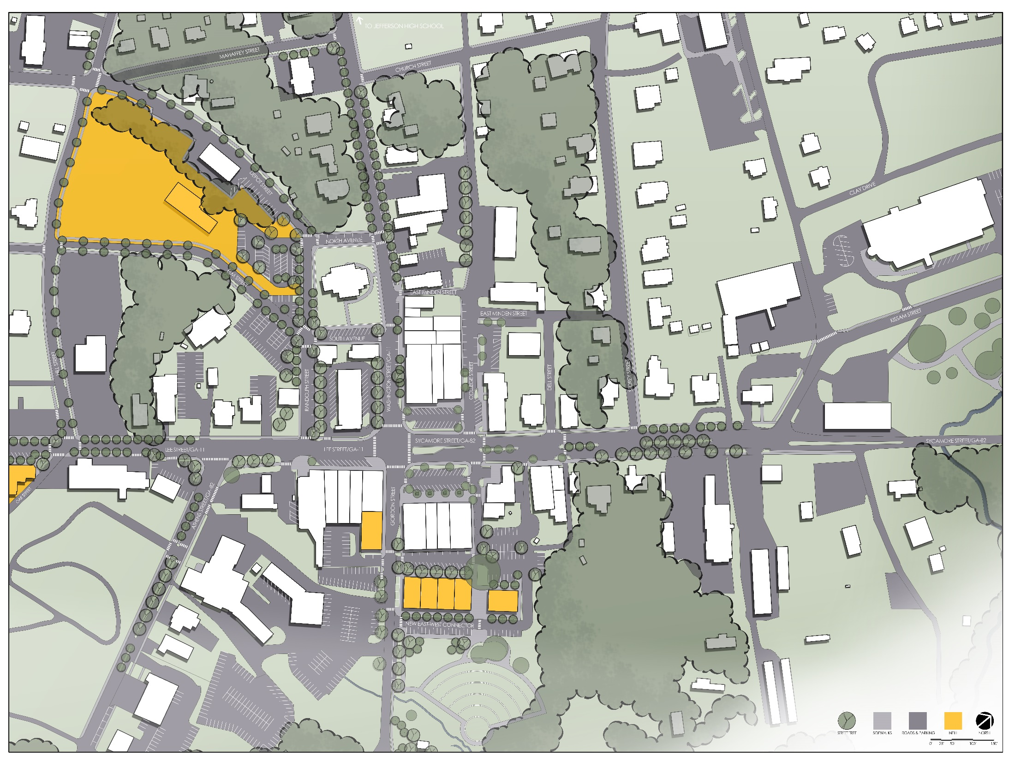
Notes:
Following a review and analysis of current conditions in Jefferson, an extensive public engagement process, and a comprehensive review of previous plans and proposals for the city, faculty and staff at the Carl Vinson Institute of Government collaborated with the citizen-led Jefferson RSVP Steering Committee to develop a guiding masterplan for the future of downtown Jefferson. This plan is intended to address the top issues that emerged during public input sessions with citizens from throughout the community, including addressing downtown parking, linking downtown with surrounding neighborhoods, connecting to new residents and visitors, improving downtown parks and recreation options, addressing the appearance of major corridors, and creating a local destination downtown. Within the plan, these issues are addressed by extending streetscaping improvements, shade, and sidewalks throughout downtown; creating an outdoor venue and greenway trail; and continuing to establish downtown Jefferson as a vibrant local destination by attracting appropriate infill development.

Slide 15
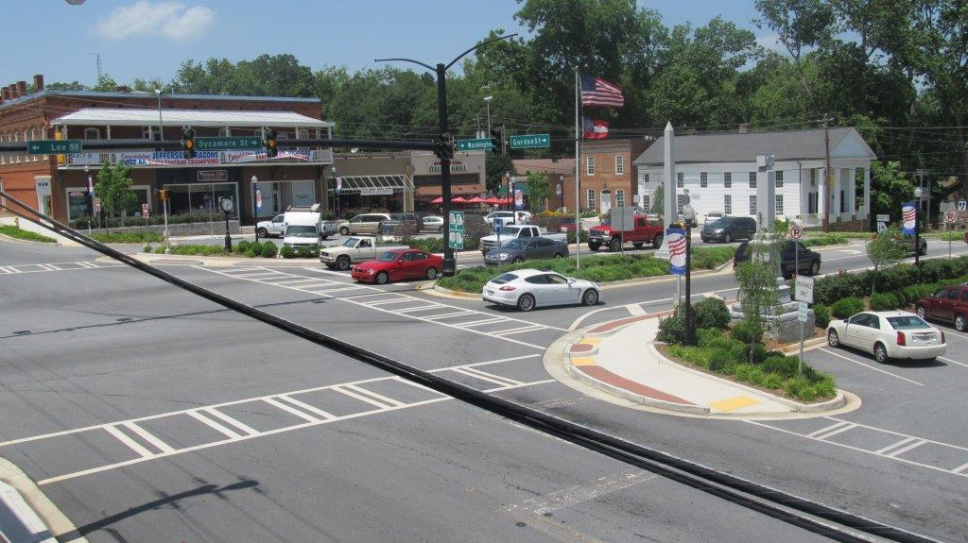
PARKING Connectivity

Slide 16
Parking Audit ^{Civic Center Area}
^{Downtown}
^{Public Spaces: 519}
^{Private Spaces: 149}
^{Civic Center Area}
^{Public Spaces: 276}
^{Private Spaces: 319}
^{Grand Total: 1,263}
Notes:
^{Parking Audit}
An inventory of public and private parking opportunities reveals the high availability of parking spaces downtown. City leaders could consider directing visitors to the many parking spaces off of the square and working with landholders to make more private lots available to the general public.

Slide 17
Before

Slide 18
Parking Signage

Slide 19
After

Slide 20
Before
Notes:
^{Parking Signage, Before}
The photograph (right) shows the side of this downtown building and a dead-end sidewalk. Limited signage exists to notify visitors of available public parking behind the building.

Slide 21
After
Notes:
^{Parking Signage, After}
The rendering (above) shows a retro 1950s-inspired vinyl print pointing the way to free public parking. Large, easily legible signage makes it easy for visitors to locate downtown parking. The existing sidewalk has been extended to connect public parking to the heart of downtown.

Slide 22
Before

Slide 23
after

Slide 24
before

Slide 25
after

Slide 26
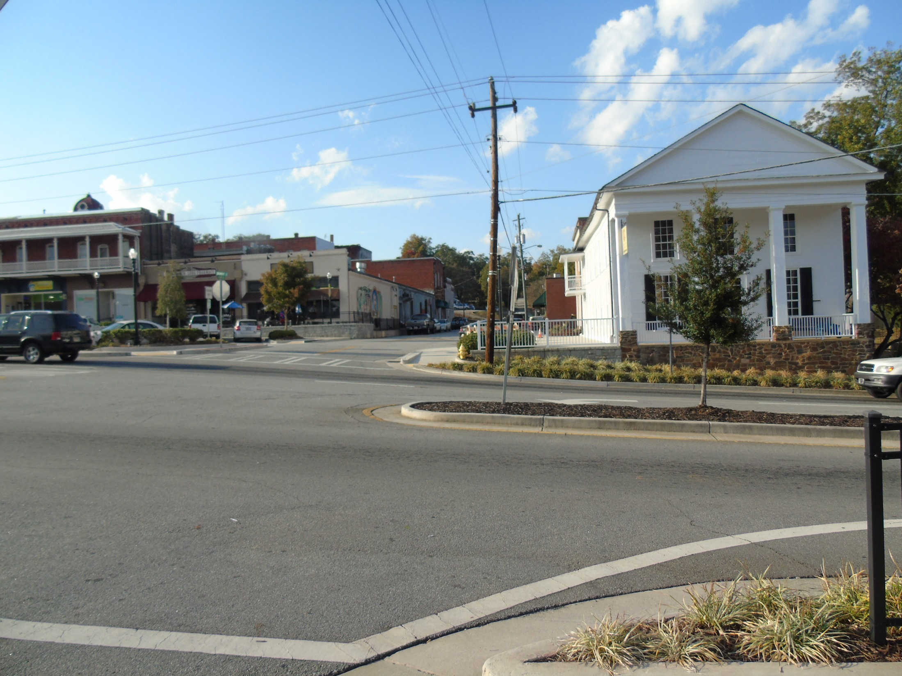
BEFORE
Notes:
Crawford D. Long Museum Crosswalk, Before
Located just off the downtown square, the Crawford W. Long Museum is a treasured asset downtown and an important local attraction. Unfortunately, the heavy vehicular traffic and lack of safe crosswalks limit pedestrian crossings in this busy heart of downtown.

Slide 27
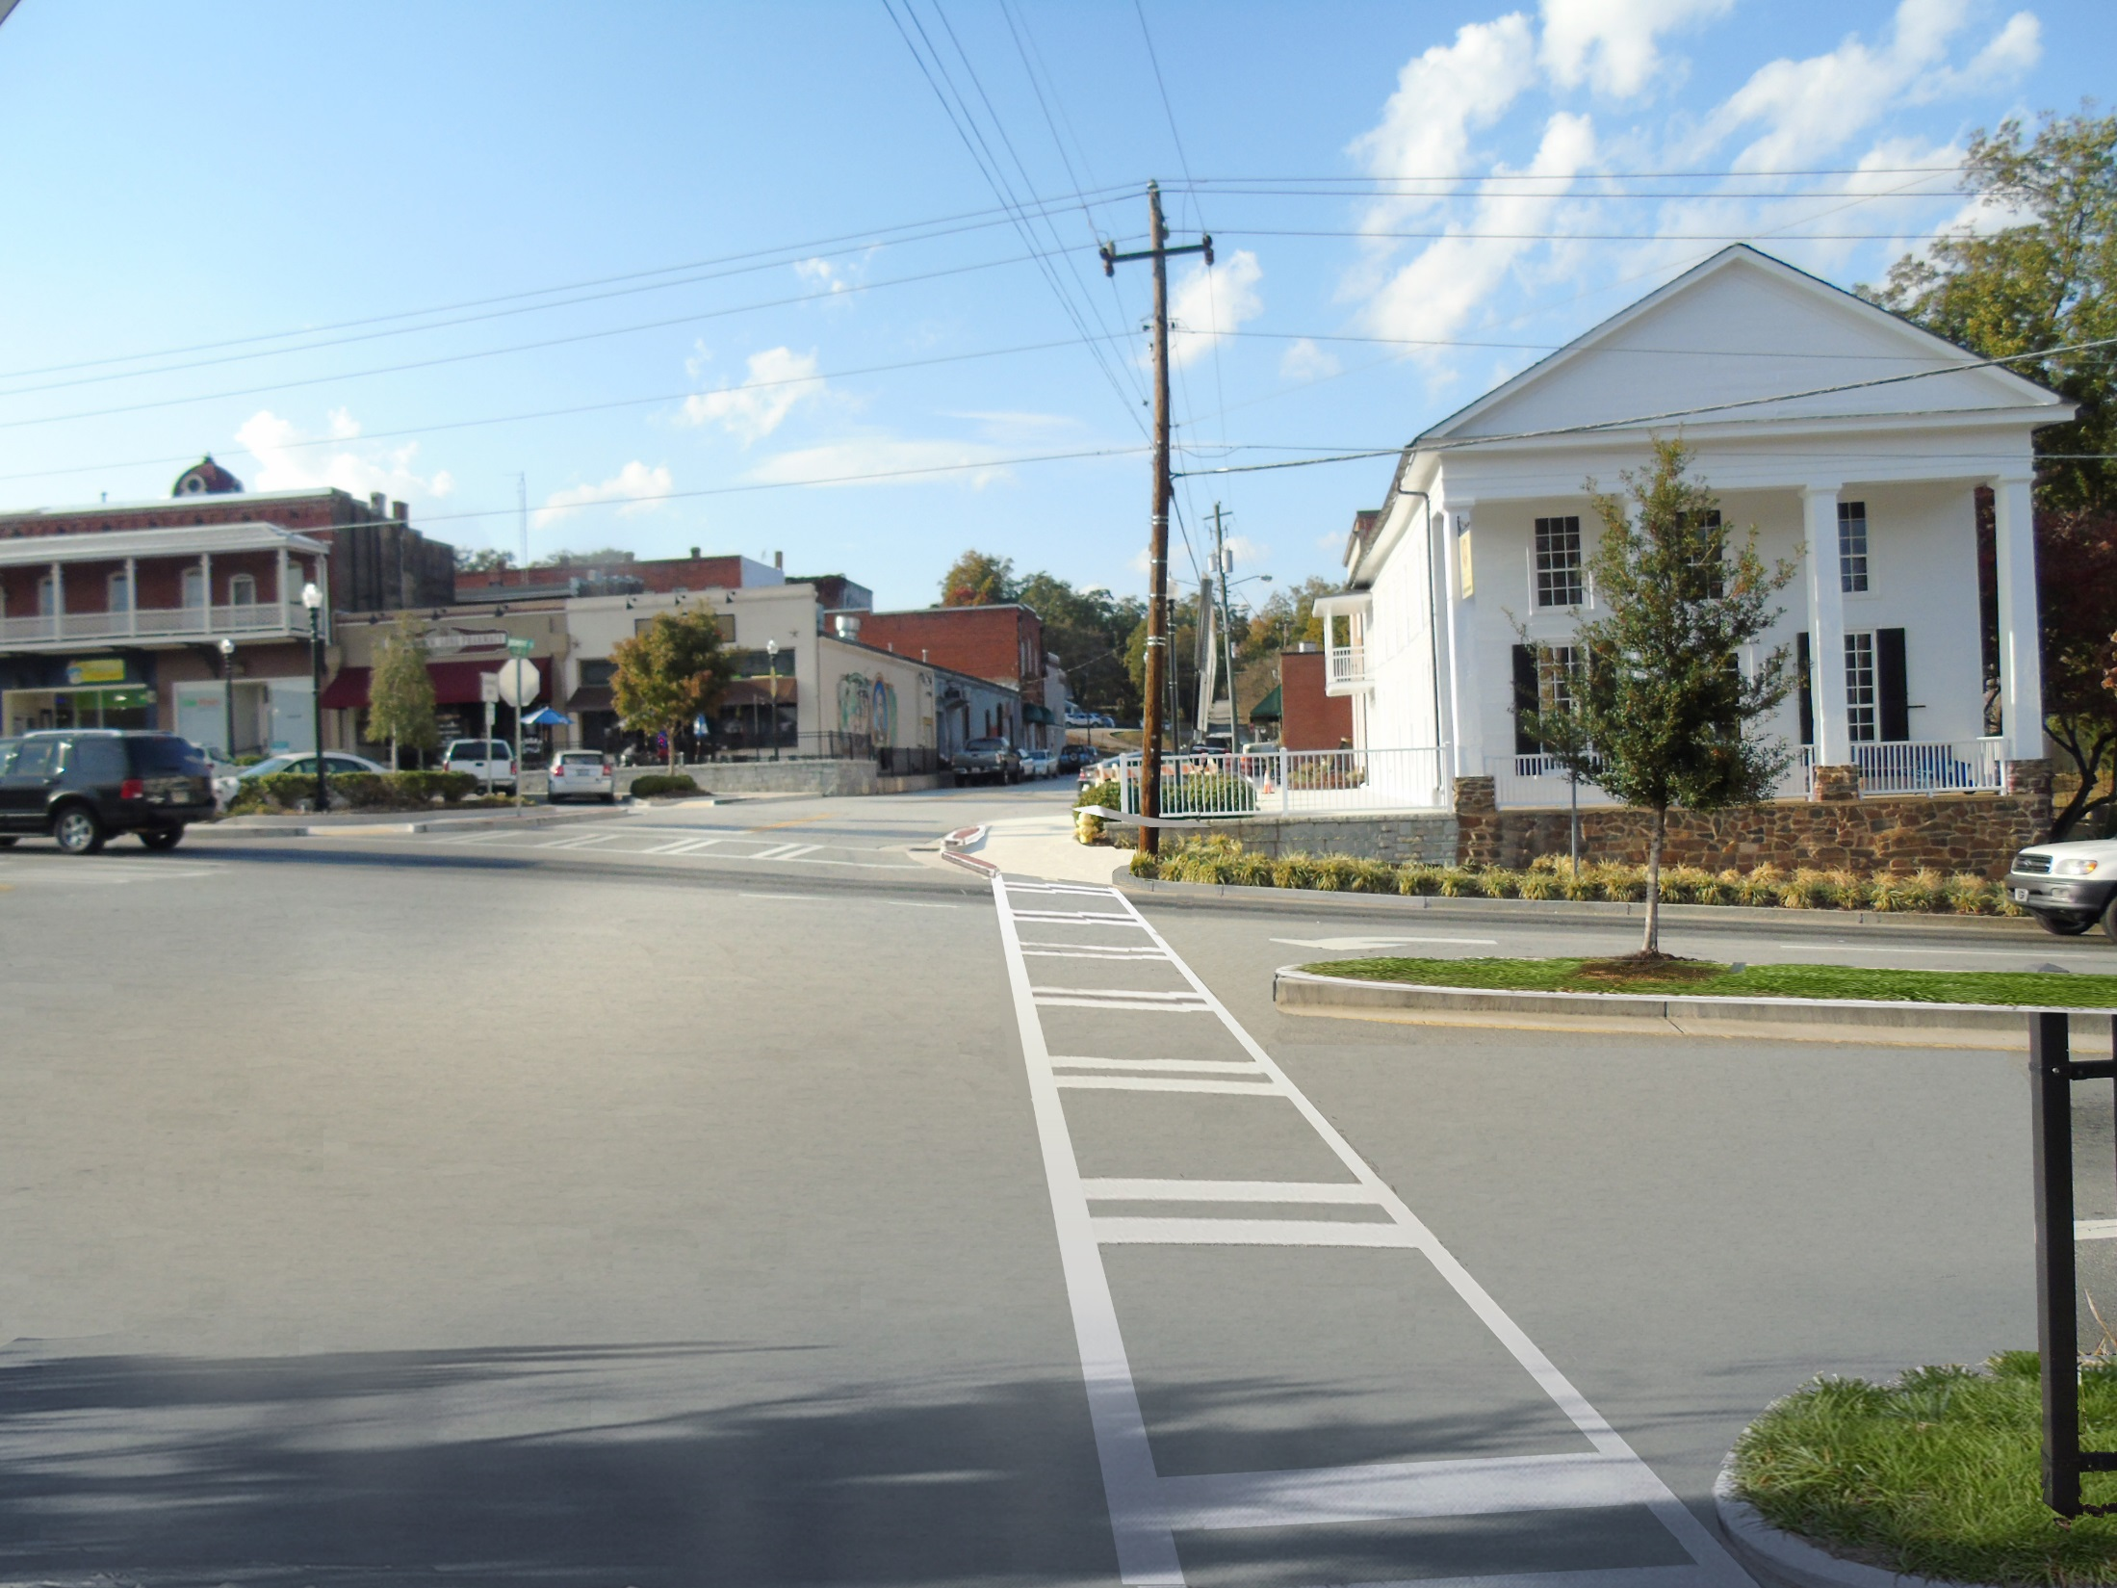
after
Notes:
Crawford D. Long Museum Crosswalk, After
This rendering shows the same view after a mid-block pedestrian crossing has been installed. One of downtown’s attractive landscaped medians provides a pedestrian refuge island.

Slide 28
Before
Notes:
^{Crosswalk Improvements, Before}
The photograph shows a view of the sidewalks and buildings along Washington Street. Currently, there are no crosswalks at this intersection, and the streetscaping could be improved.

Slide 29
after
Notes:
^{Crosswalk Improvements, After}
The rendering shows an improved pedestrian crossing with a painted crosswalk and planted bump-outs.

Slide 30
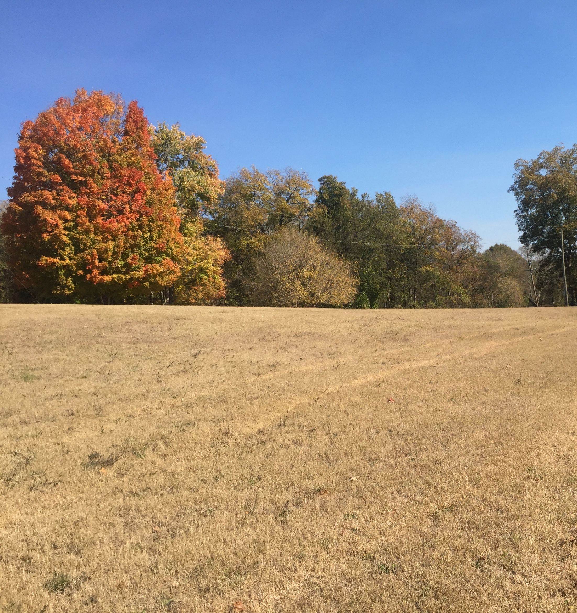
PARKS & GREENSPACE

Slide 31
before
Notes:
^{Woodbine Cemetery, After}
As shown in the rendering, large willow oaks provide needed shade and improve an existing downtown green space.

Slide 32
After
Notes:
^{Woodbine Cemetery, Before}
This photo shows a view of the tranquil, beautiful, and historic Woodbine-Jefferson cemetery.

Slide 33
AMPITHEATER,
PLAN VIEW
Notes:
^{Amphitheater /}
^{Music Venue, Plan View}
This plan view shows what the new ampitheater could look like.

Slide 34
before
Notes:
Amphitheater / Music Venue, Before
Located adjacent to the Reverend V.S. Hughey Park on Gordon Street, this attractive DDA-owned property just south of downtown represents a major opportunity for development downtown. With mature native trees and a sloping location adjacent to a tributary of Curry Creek, this property was commonly brought up as a potential outdoor music venue during public input sessions.

Slide 35
AFTER,
SHORT-TERM
Notes:
Amphitheater / Music Venue, Short-term
In this short-term treatment, only a stage has been installed. Rather than constructing seat walls and moving earth, visitors bring their own blankets to enjoy music and performances along the scenic hillside.

Slide 36
AFTER,
LONG-TERM
Notes:
Amphitheater / Music Venue, Long-term
Granite seat walls reflecting the materials palette of the downtown streetscape provide an attractive perch for concert-goers. Large shade trees have been retained and incorporated into the final design, and the formerly incised stream has been restored to health by broadening the channel and installing native wetland plantings.

Slide 37
AFTER
Notes:
^{Amphitheater / Music Venue}
The rendering below shows what the new amphitheater could look like. Trees are planted on grass steps to provide shade and context-appropropriate mixed-use infill can be seen in the background.

Slide 38
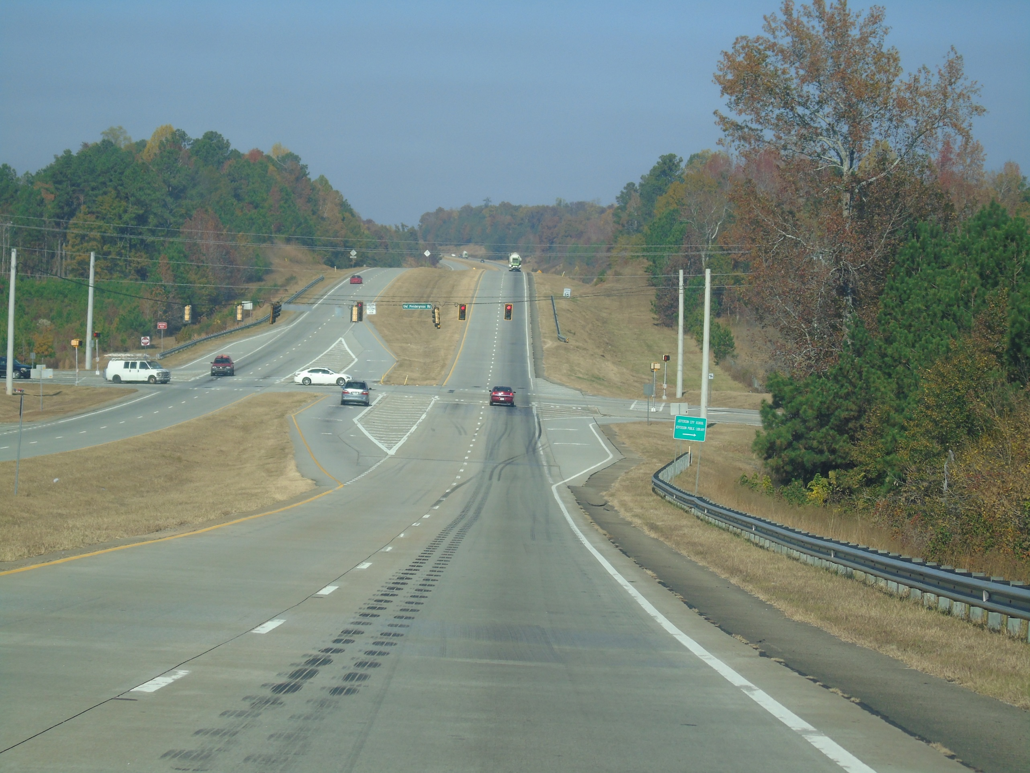
Signage Connecting Residents and Visitors

Slide 39
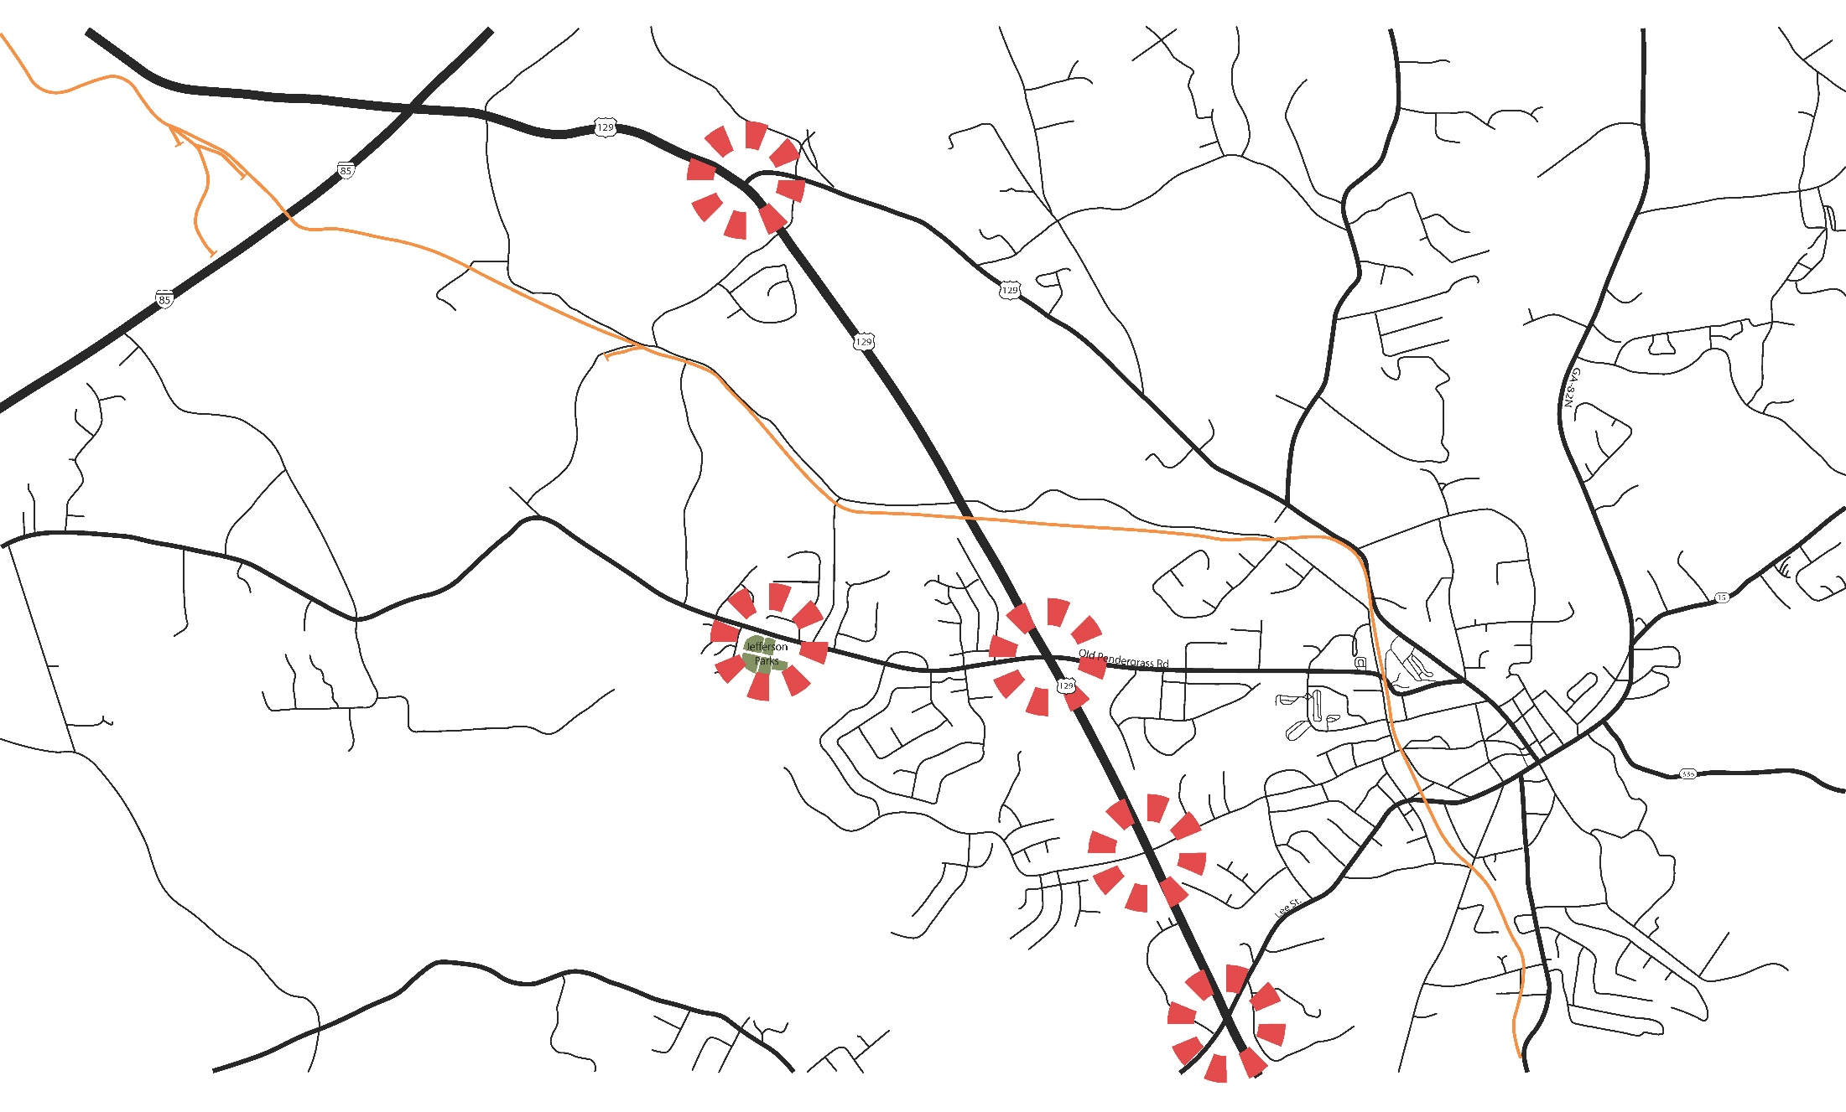
Notes:
^{Gateway Locations}
The map above shows five key gateway locations where gateway signage would direct visitors to the various routes downtown, including: US-129 and US-129 BUS, Jefferson Parks and Recreation on Old Pendergrass Road, US-129 and Old Pendergrass Road, US-129 and Winder Highway, and US-129 and Lee Street.

Slide 40
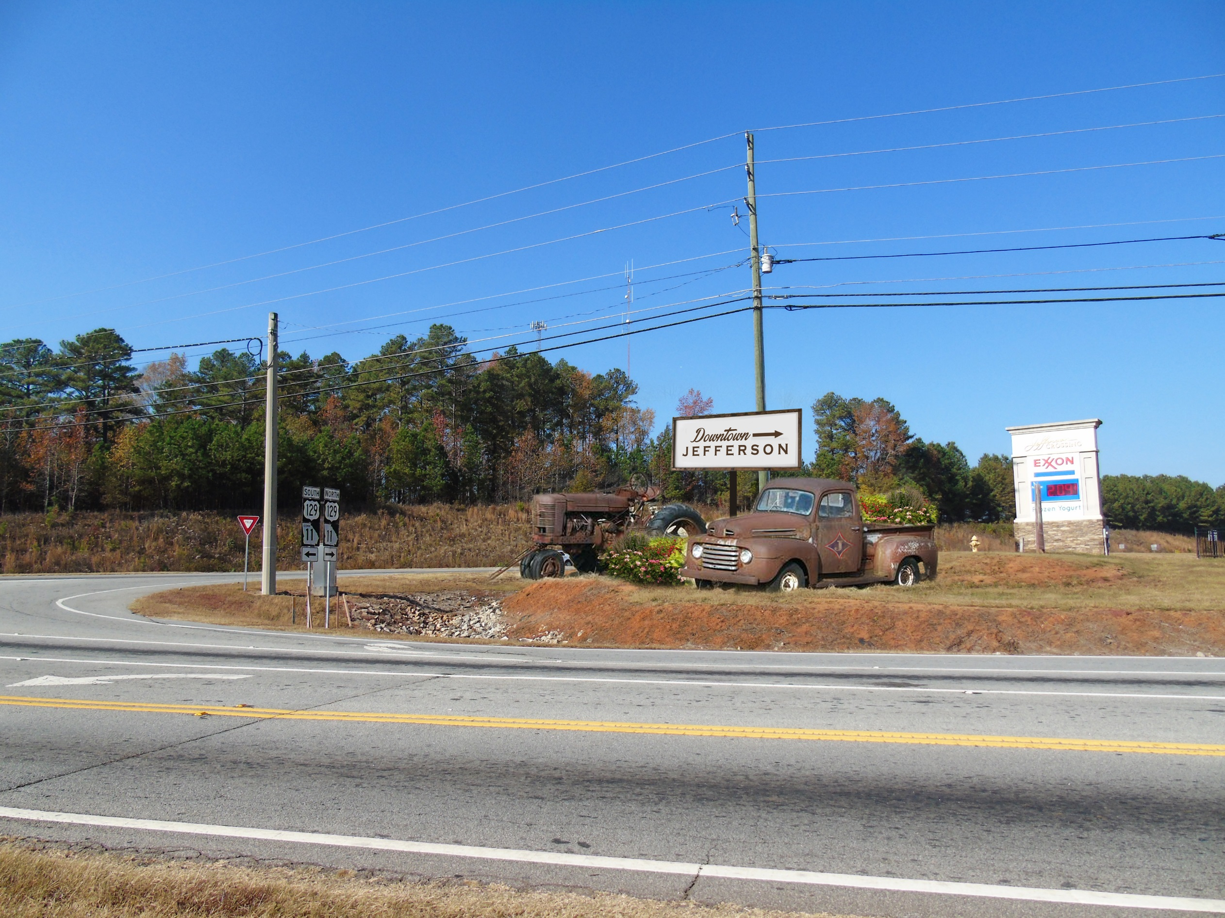
Notes:
^{Gateway Signage, Concept 2}
The rendering above shows an old tractor and truck planted with flowers and a painted wooden sign placed at the corner of US-129 and Winder Highway, where Exxon is located.

Slide 41
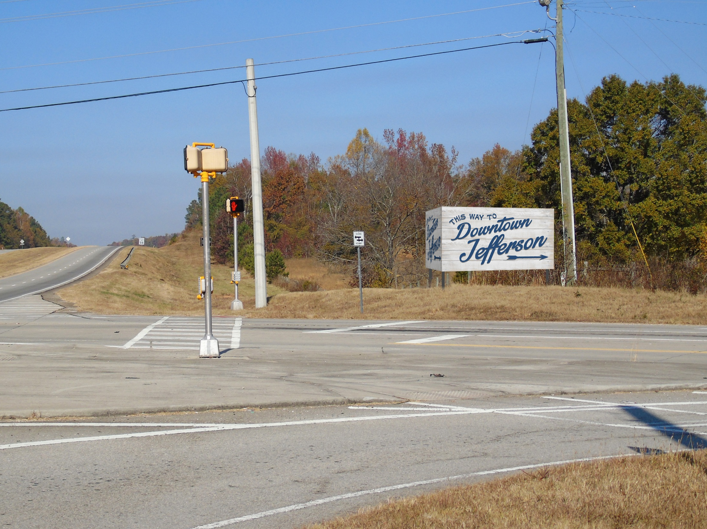
Notes:
^{Gateway Signage, Concept 1}
The rendering above shows a painted wooden sign placed at the corner of US-129 and Old Pendergrass Road (across from the Kroger shopping center).

Slide 42
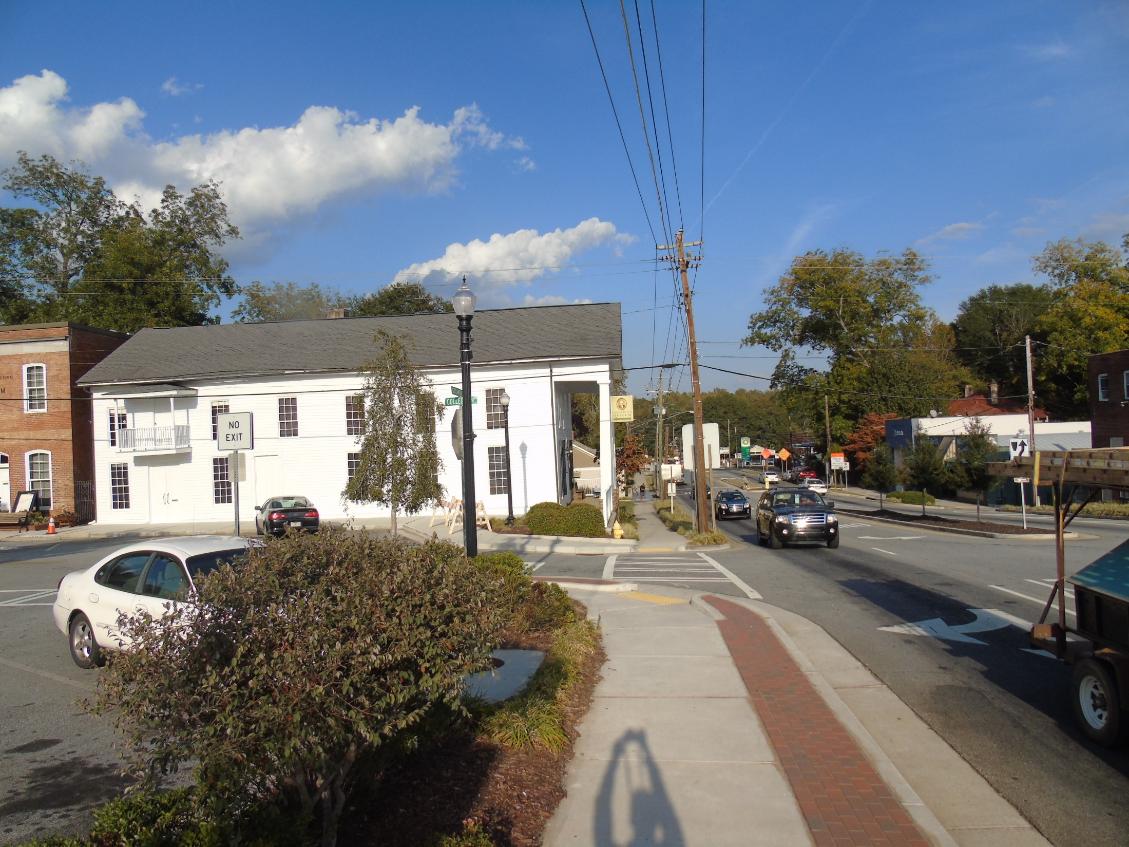
before
Notes:
^{Business Signage, Before}
The photo shows a view of Sycamore Street, a main downtown business hub, looking toward the Crawford W. Long Museum. Currently, no signage indicates where downtown’s landmarks and businesses are located.

Slide 43
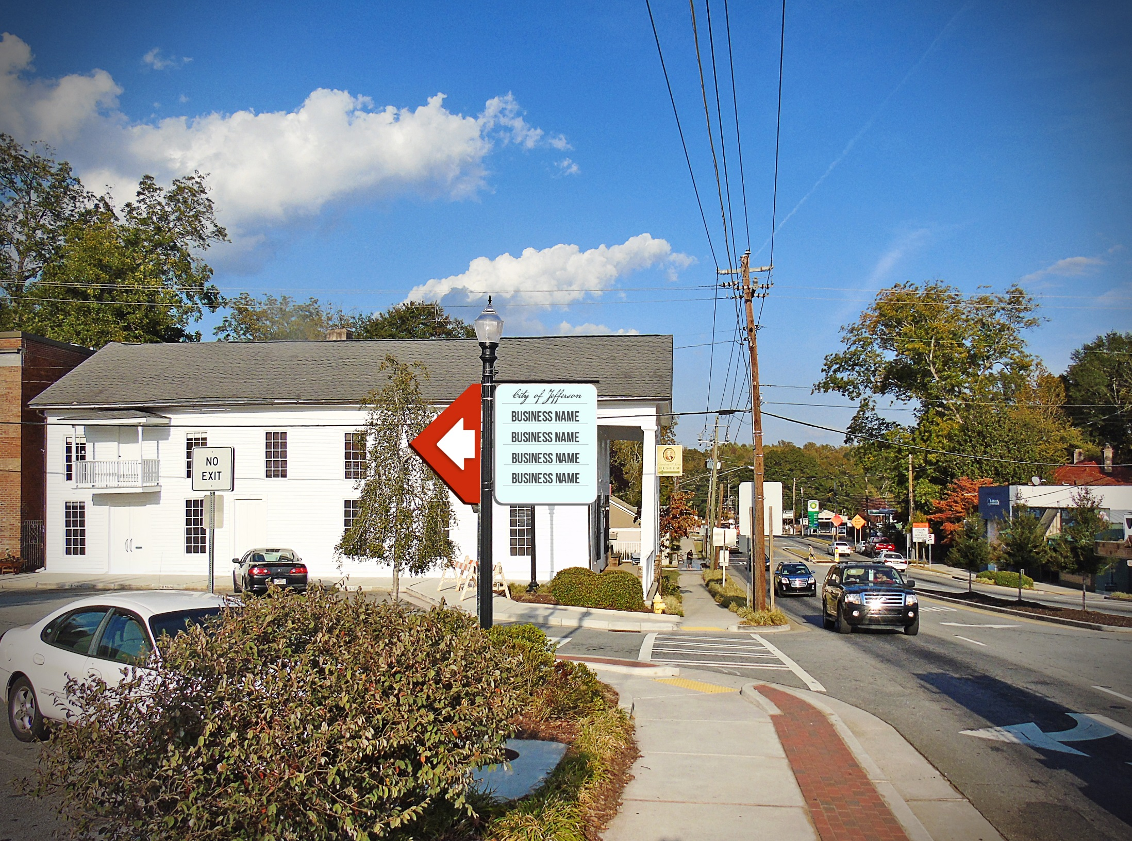
After
Notes:
^{Business Signage, After}
Attractive wayfinding signage is important for visitors to easily discover all that downtown Jefferson has to offer. The rendering shows one of many simple signage design options that could easily be installed downtown to direct visitors to local landmarks and businesses.

Slide 44
Before
Notes:
^{Thomas Jefferson Mural, Before}
The photograph shows a blank wall on a downtown building.

Slide 45
after
Notes:
^{Thomas Jefferson Mural, After}
Taking advantage of signage opportunities like this blank wall, Jefferson could commission local artists to paint Thomas Jefferson–themed murals around town to celebrate and honor the Founding Father that the city is named after.

Slide 46
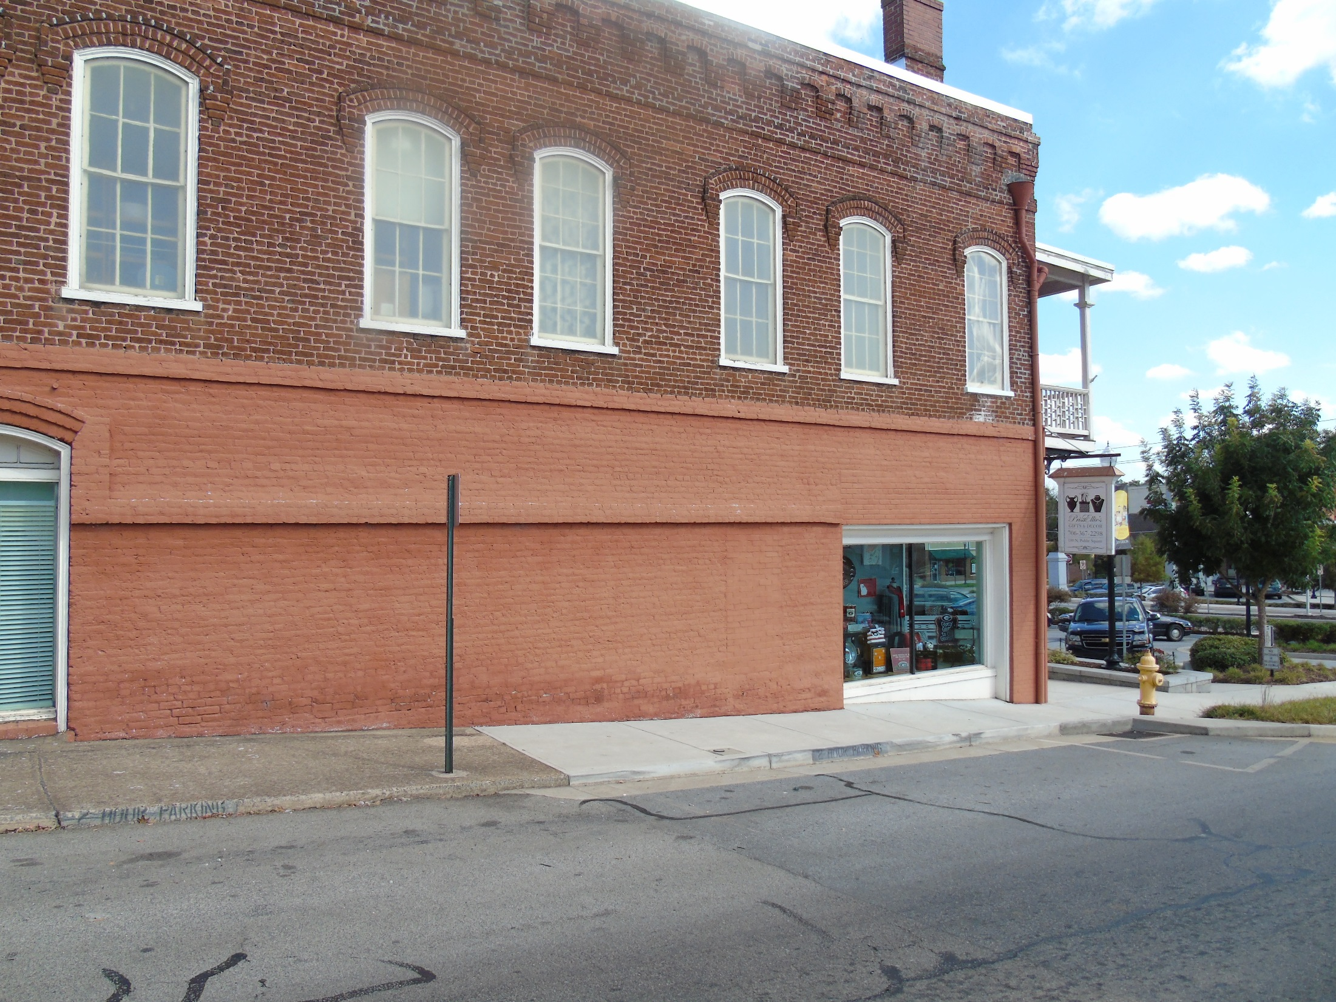
Before

Slide 47
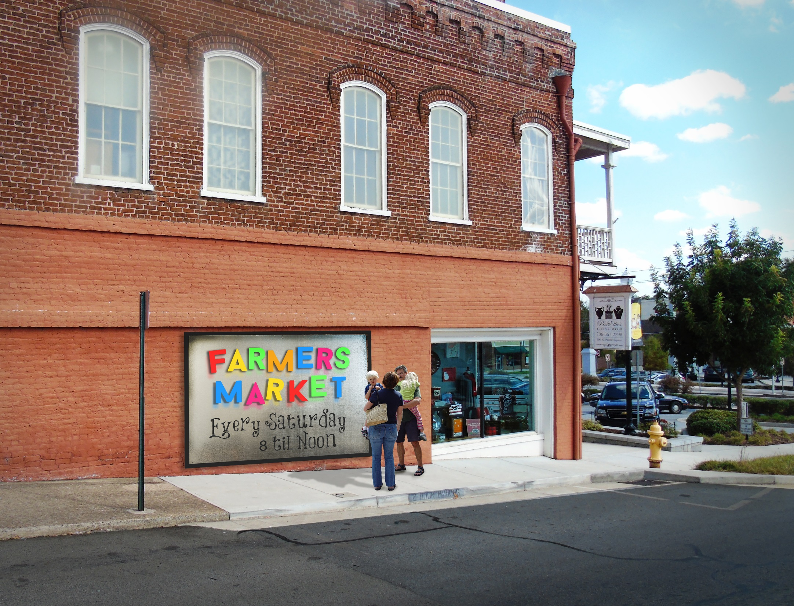
After

Slide 48
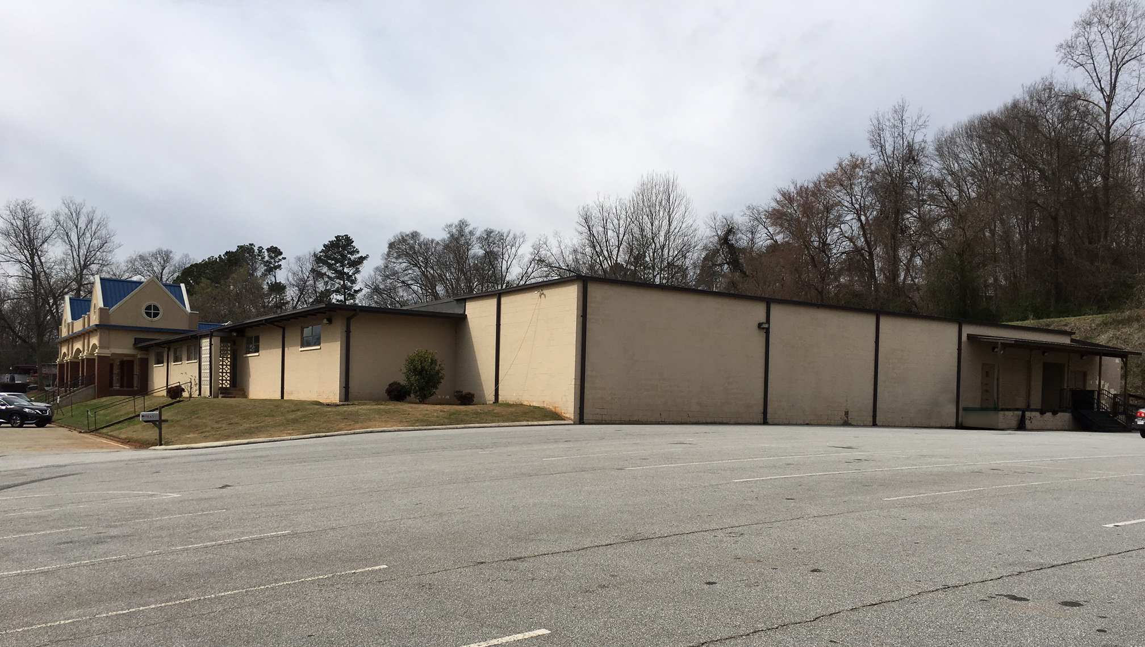
Before

Slide 49
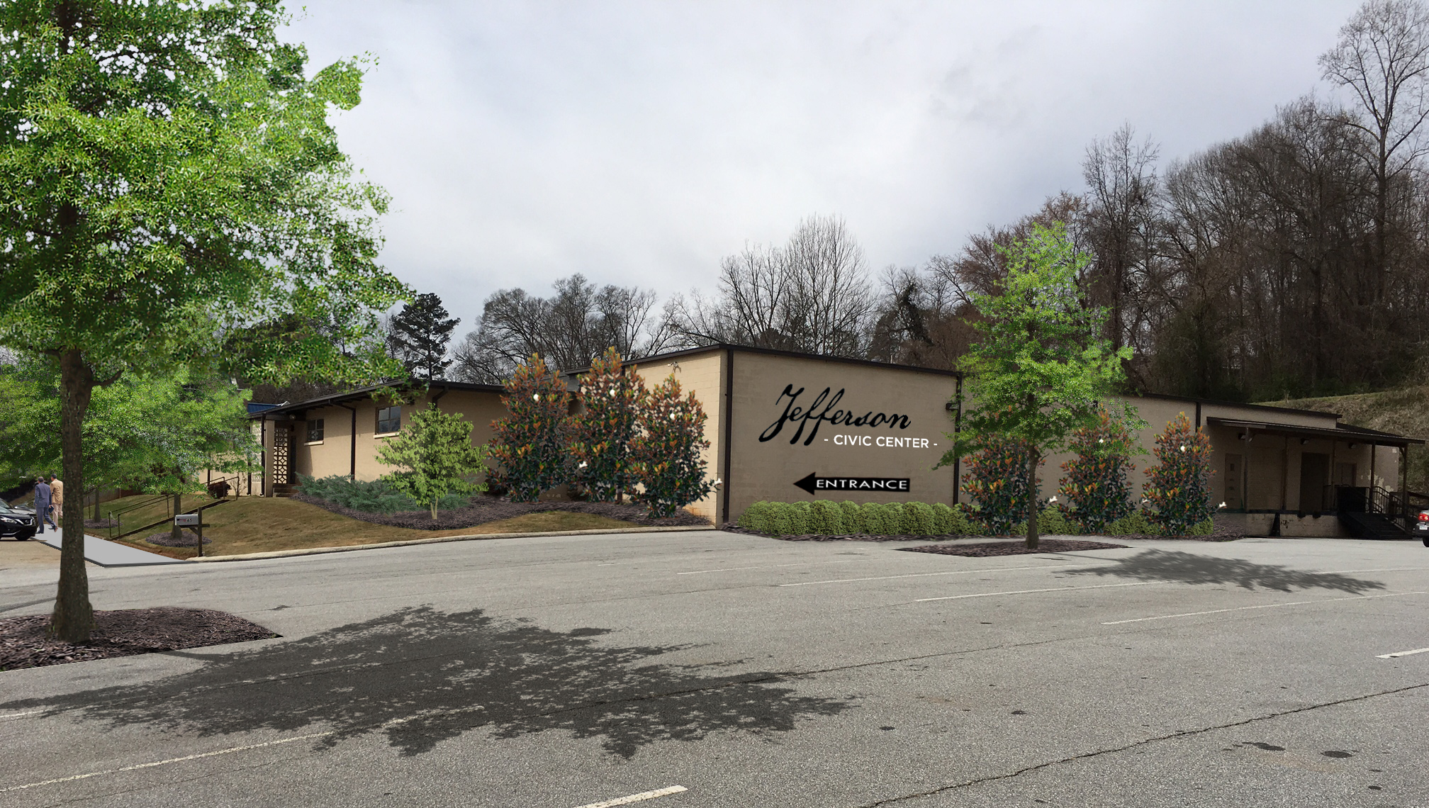
After
Notes:
Sidewalk added along existing parking lot. A landscaping strip has been installed between the parking lot and the building. Plants include Little Gem Magnolias, yaupon holly, juniper, and a specimen dogwood. Parking spaces have been removed and planted with willow oaks.

Slide 50
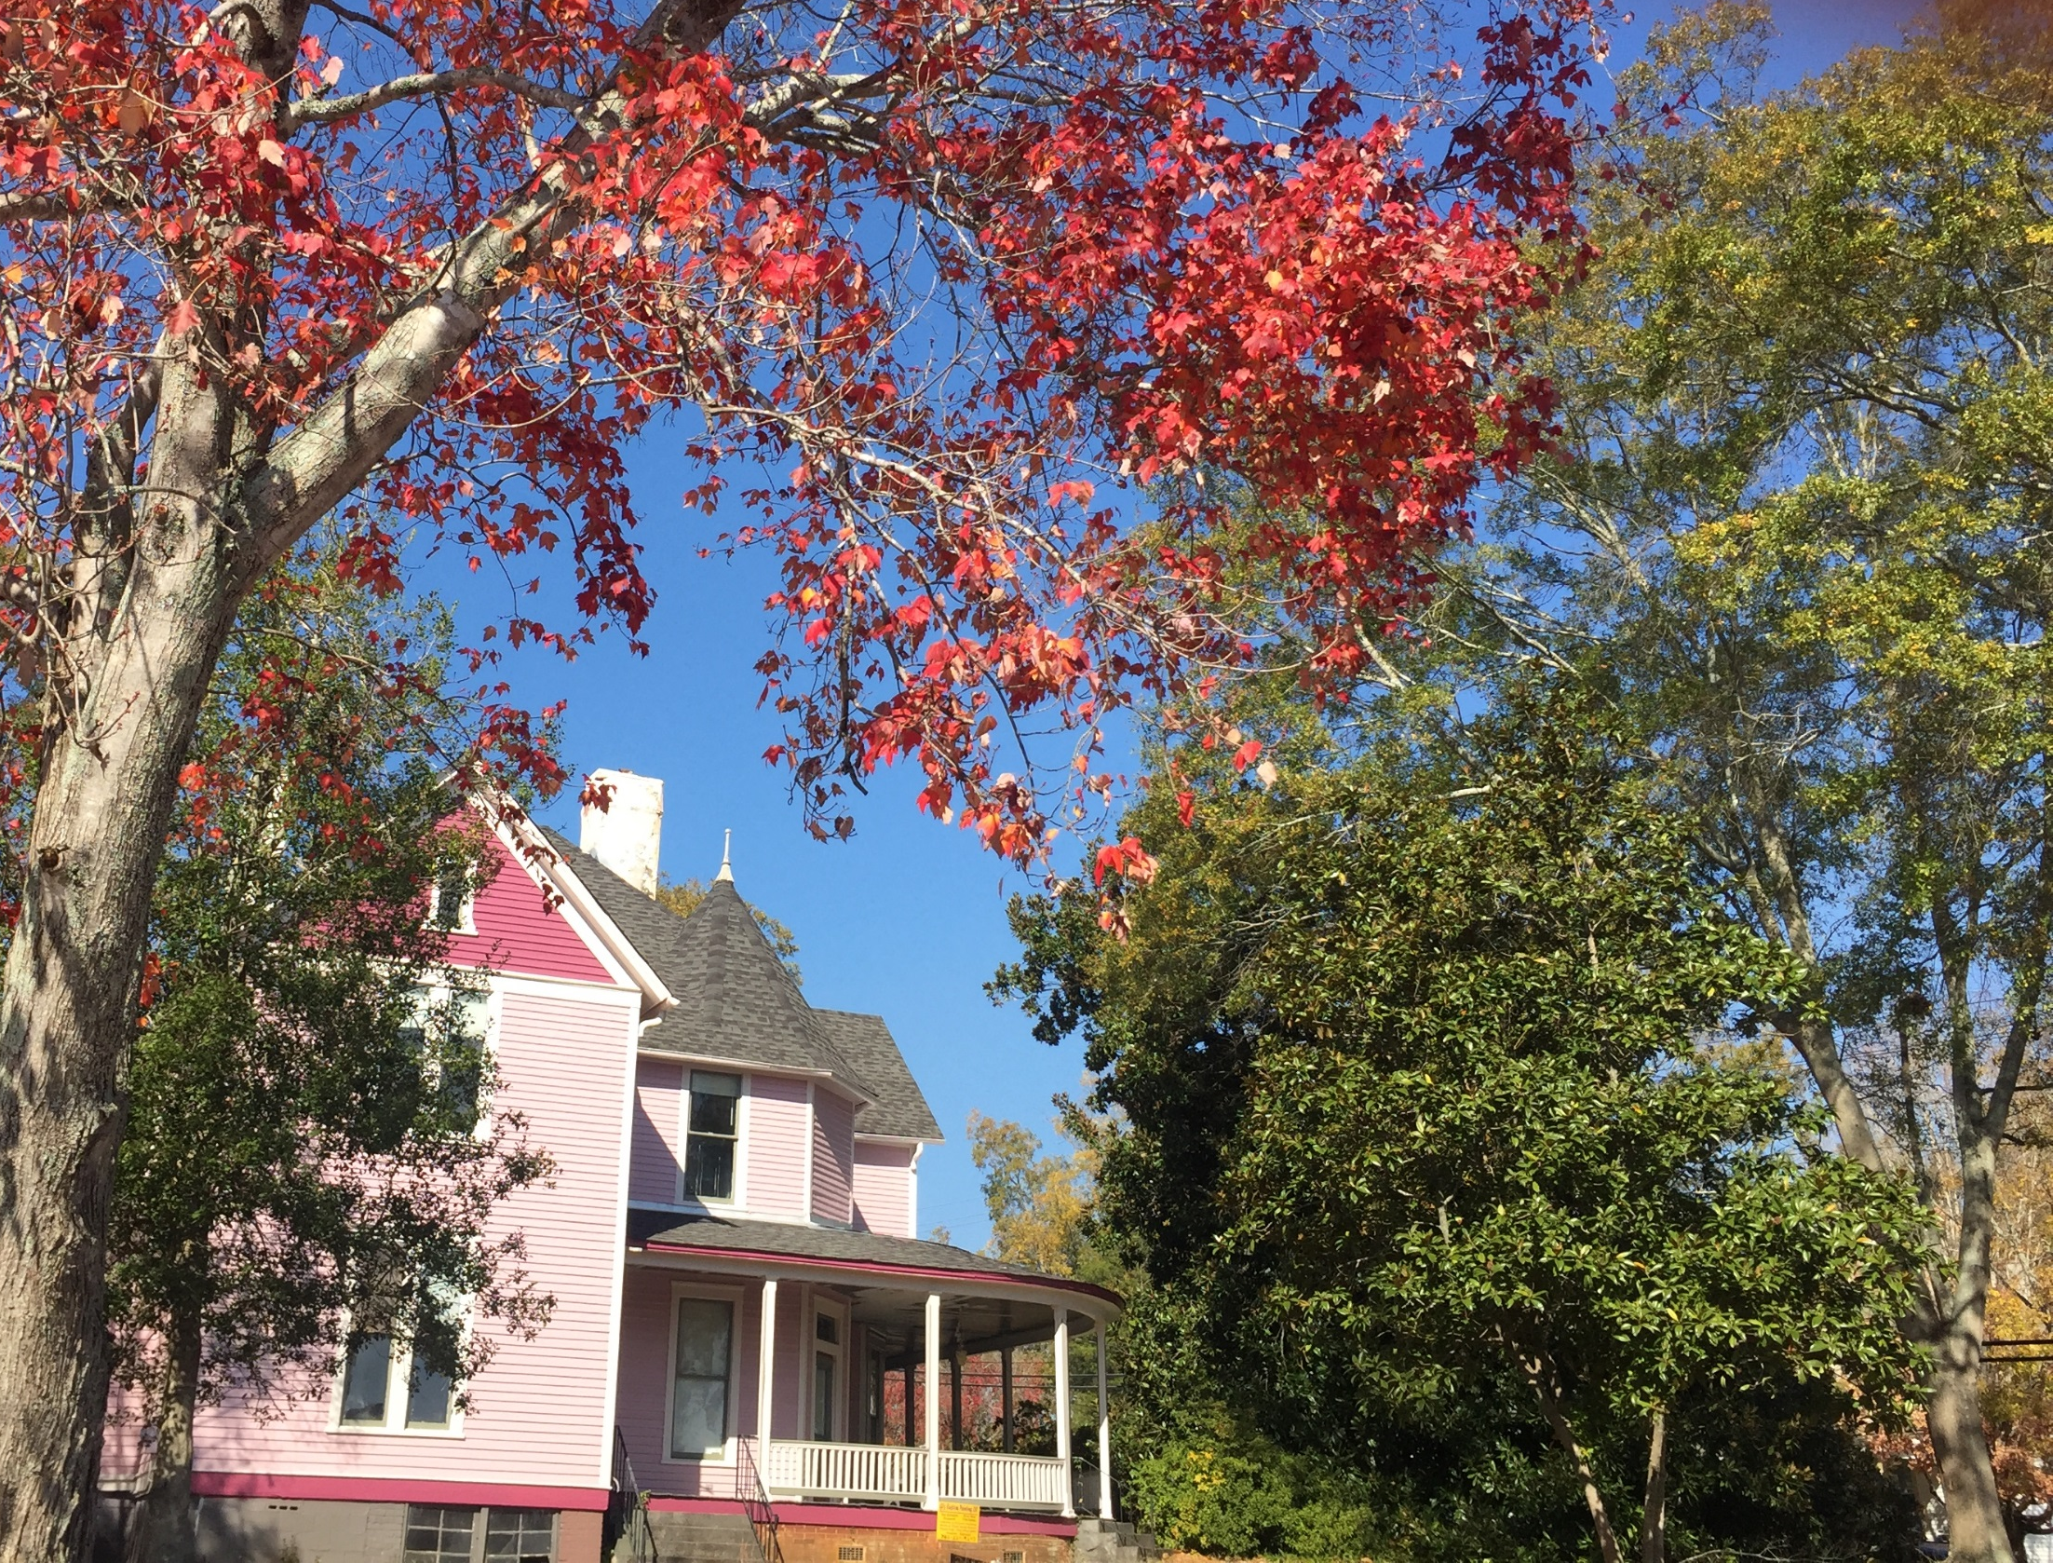
Gateways & Corridors

Slide 51
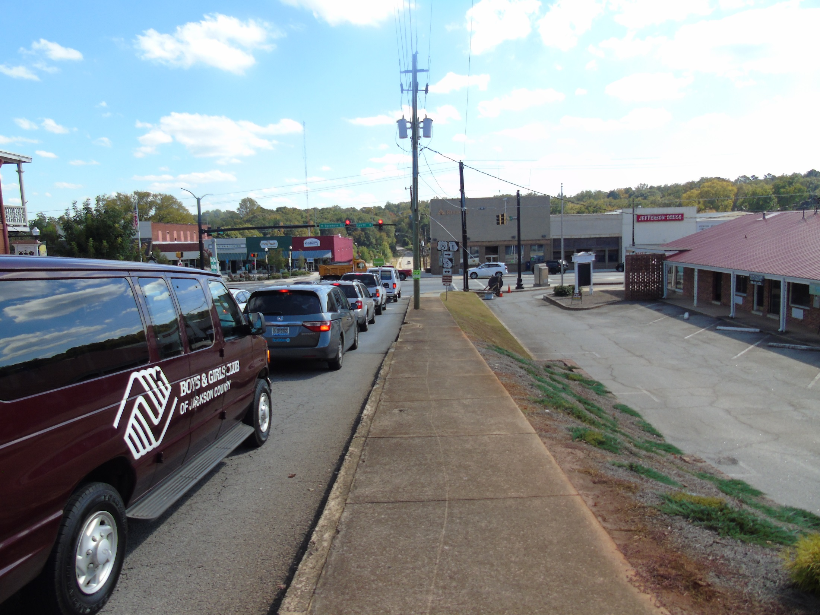
BEFORE
Notes:
^{Washington Street, Before}
Currently Washington Street leading into downtown is a well-traveled connector paralleling the US 129 bypass. This view shows a lack of street trees and shade, which makes pedestrian travel unattractive along this stretch of Washington Street. The former hotel located to the right in this image was a frequently mentioned during public input sessions as a site ripe for improvement.

Slide 52
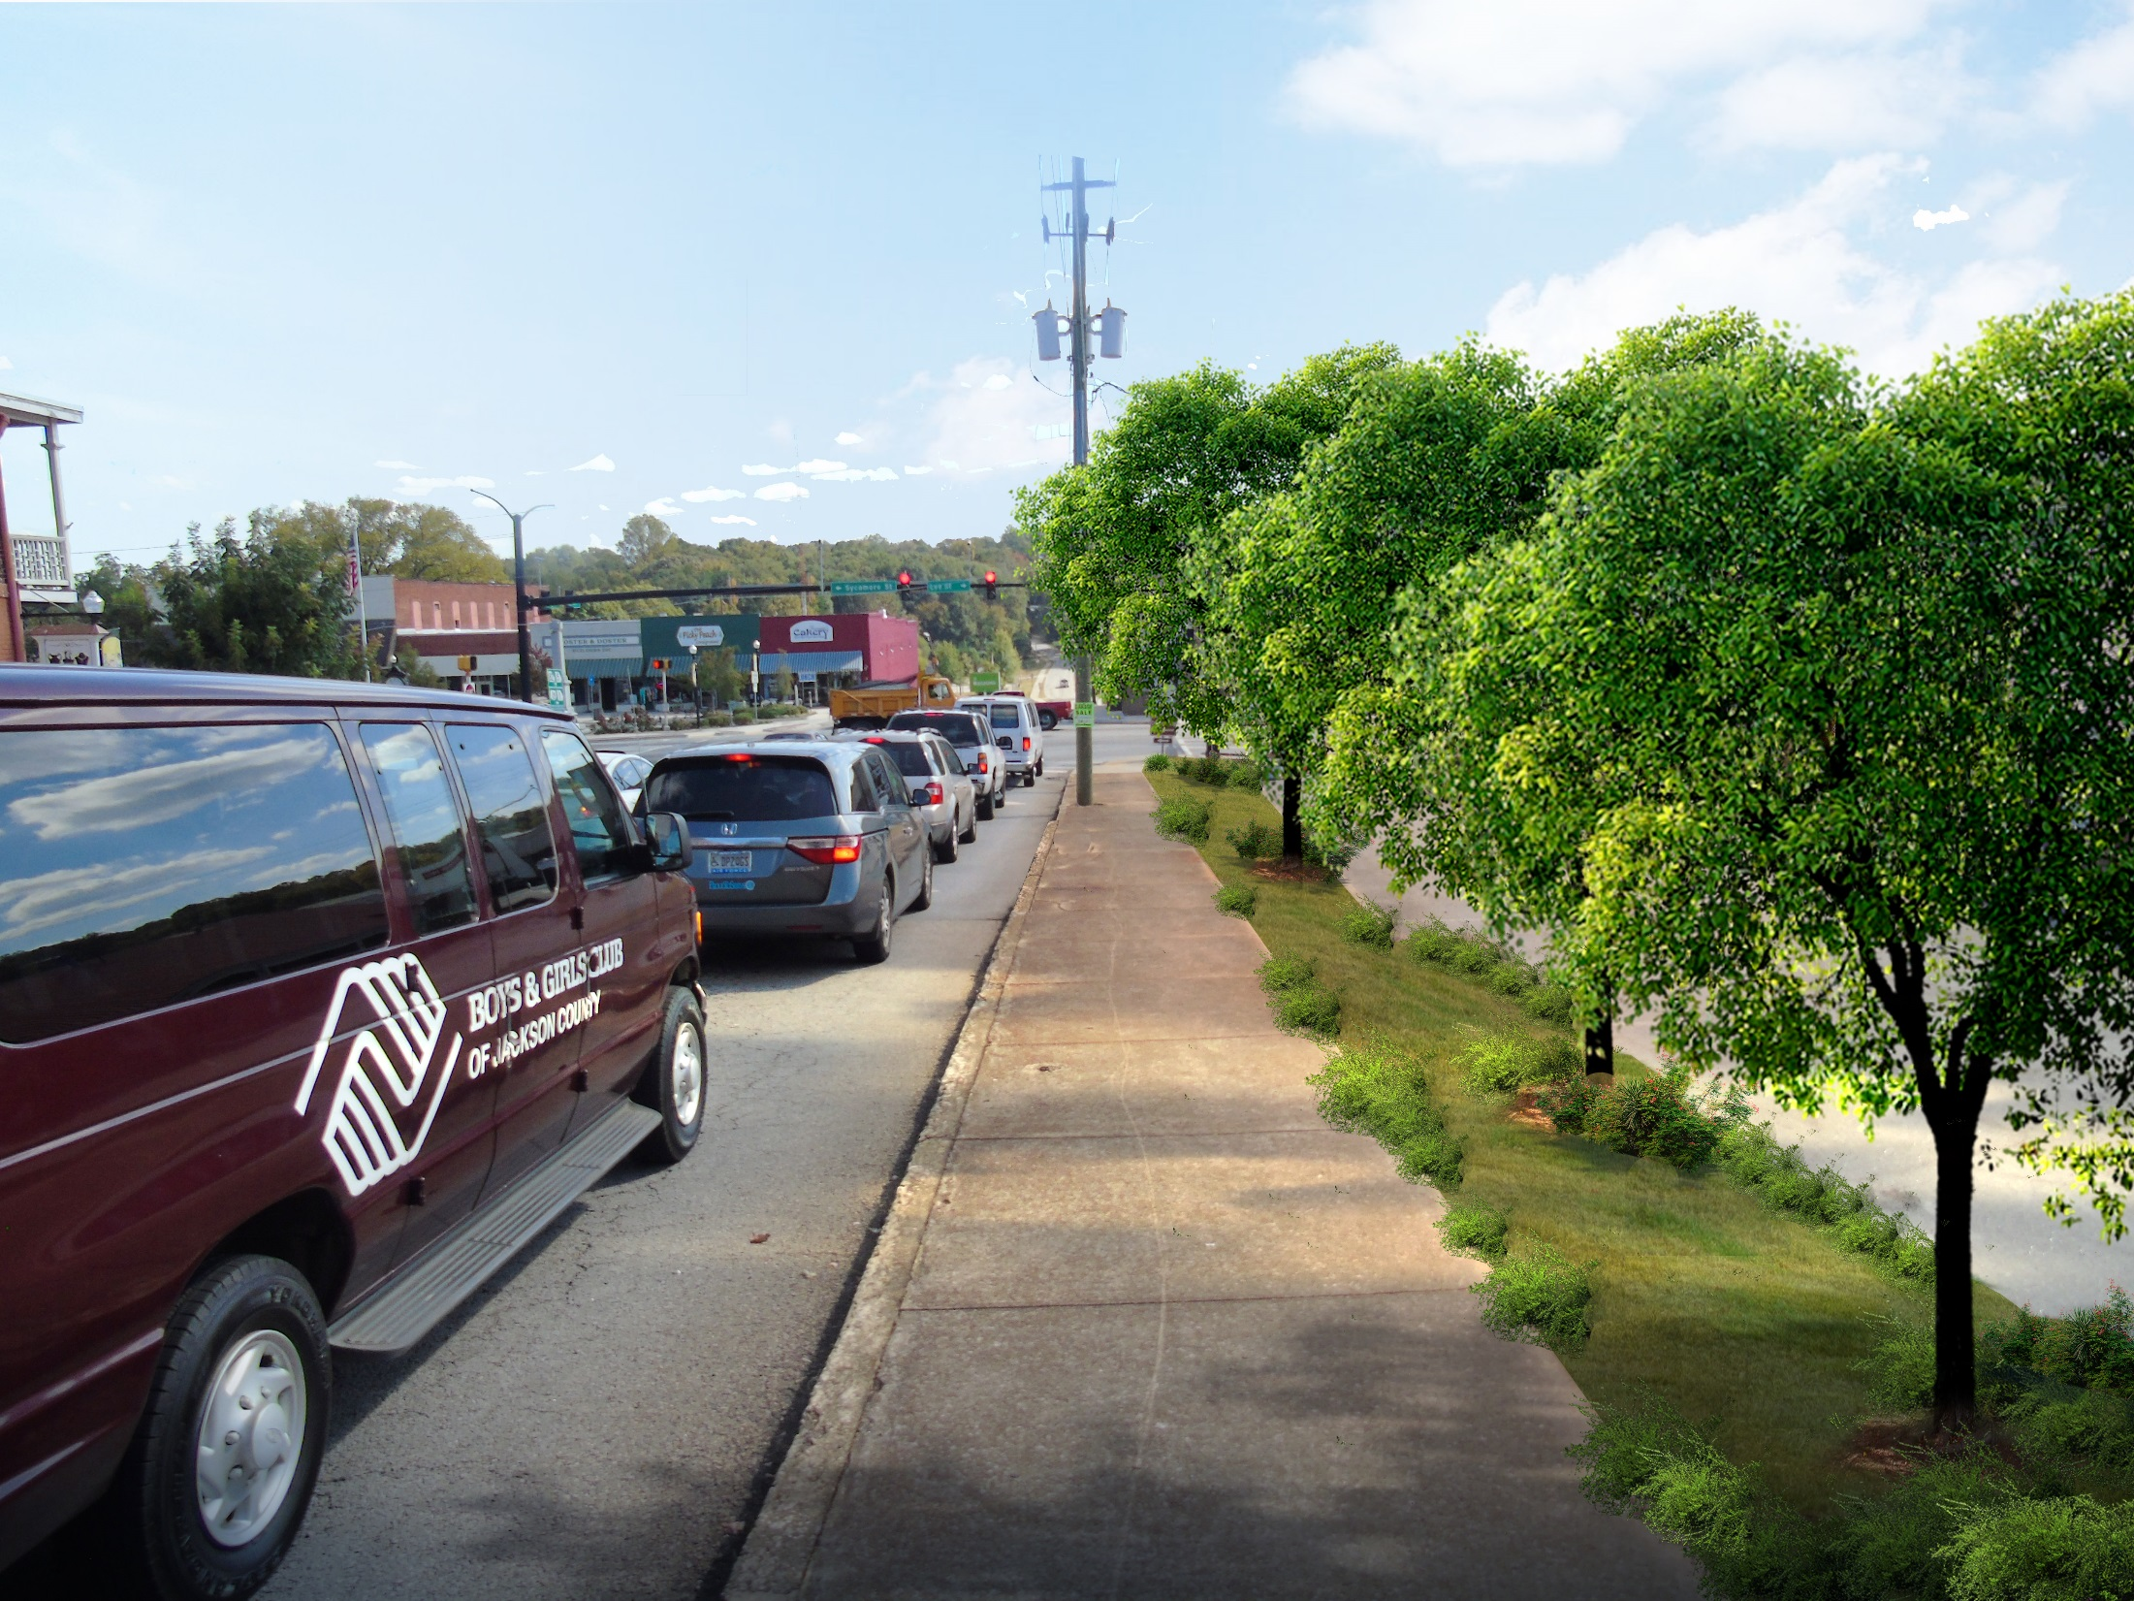
after
Notes:
^{Washington Street, After}
This perspective shows the same view after a line of street trees has been planted. These trees now buffer views of the former hotel and parking lot while providing shade.

Slide 53
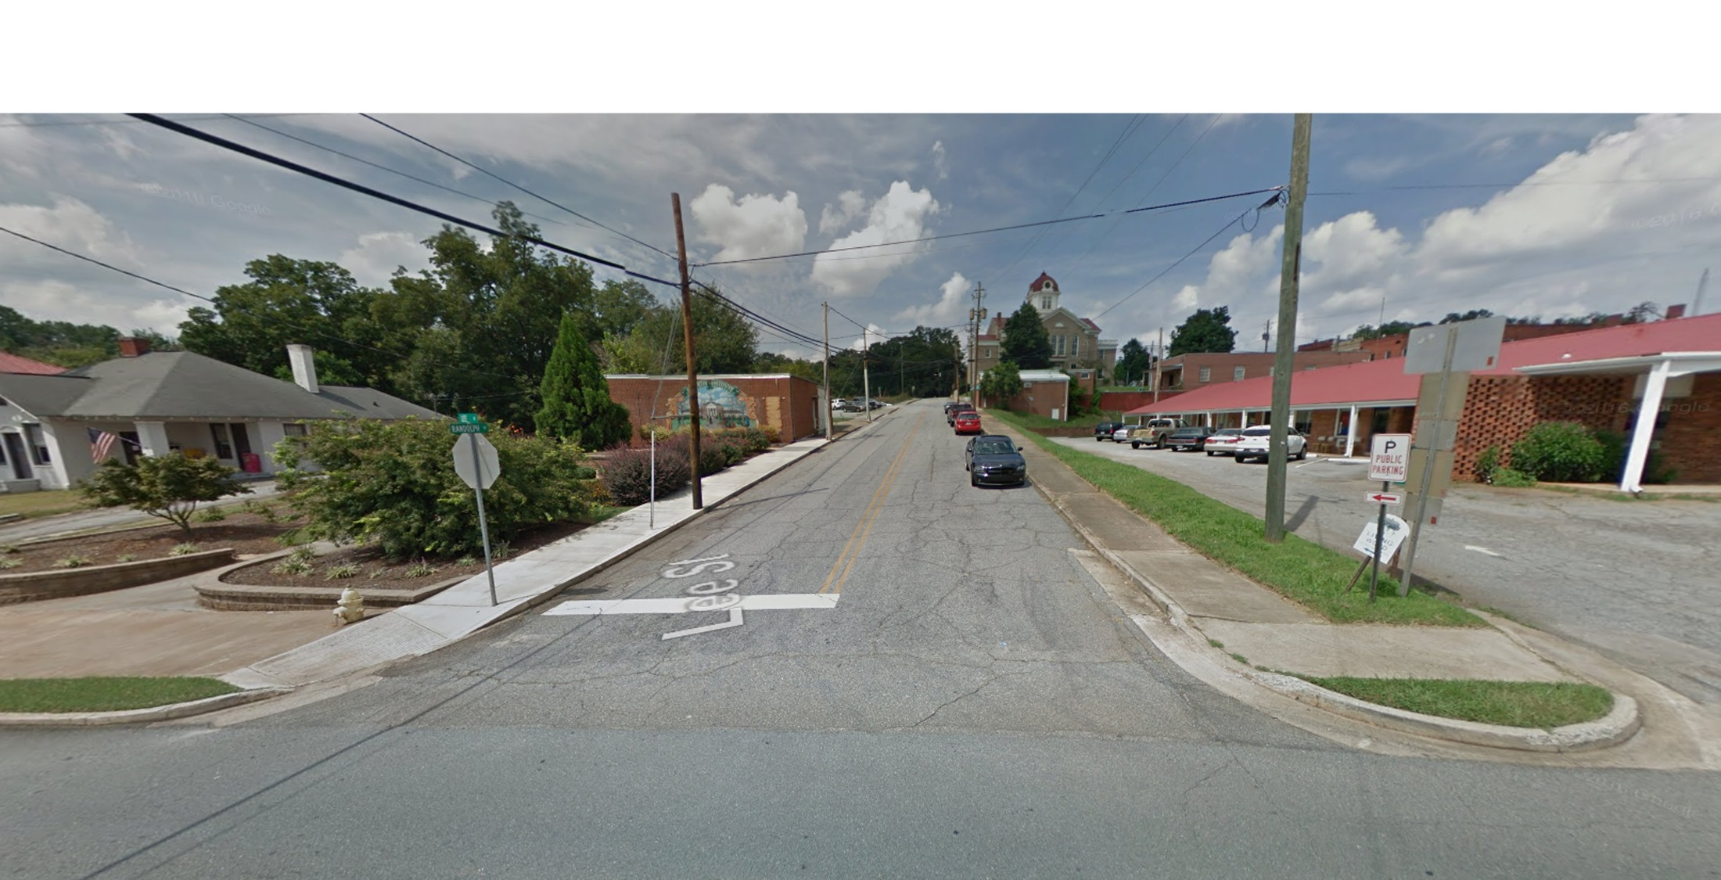
BEFORE
Notes:
^{Randolph Street, Before}
This photo at the corner of Lee and Randolph Streets shows the existing Martin Institute mural and adjacent pocket park— elements that attract downtown street life. Despite these strengths, the current lack of shade and dated motel building could be made more attractive by strategic landscape plantings.

Slide 54
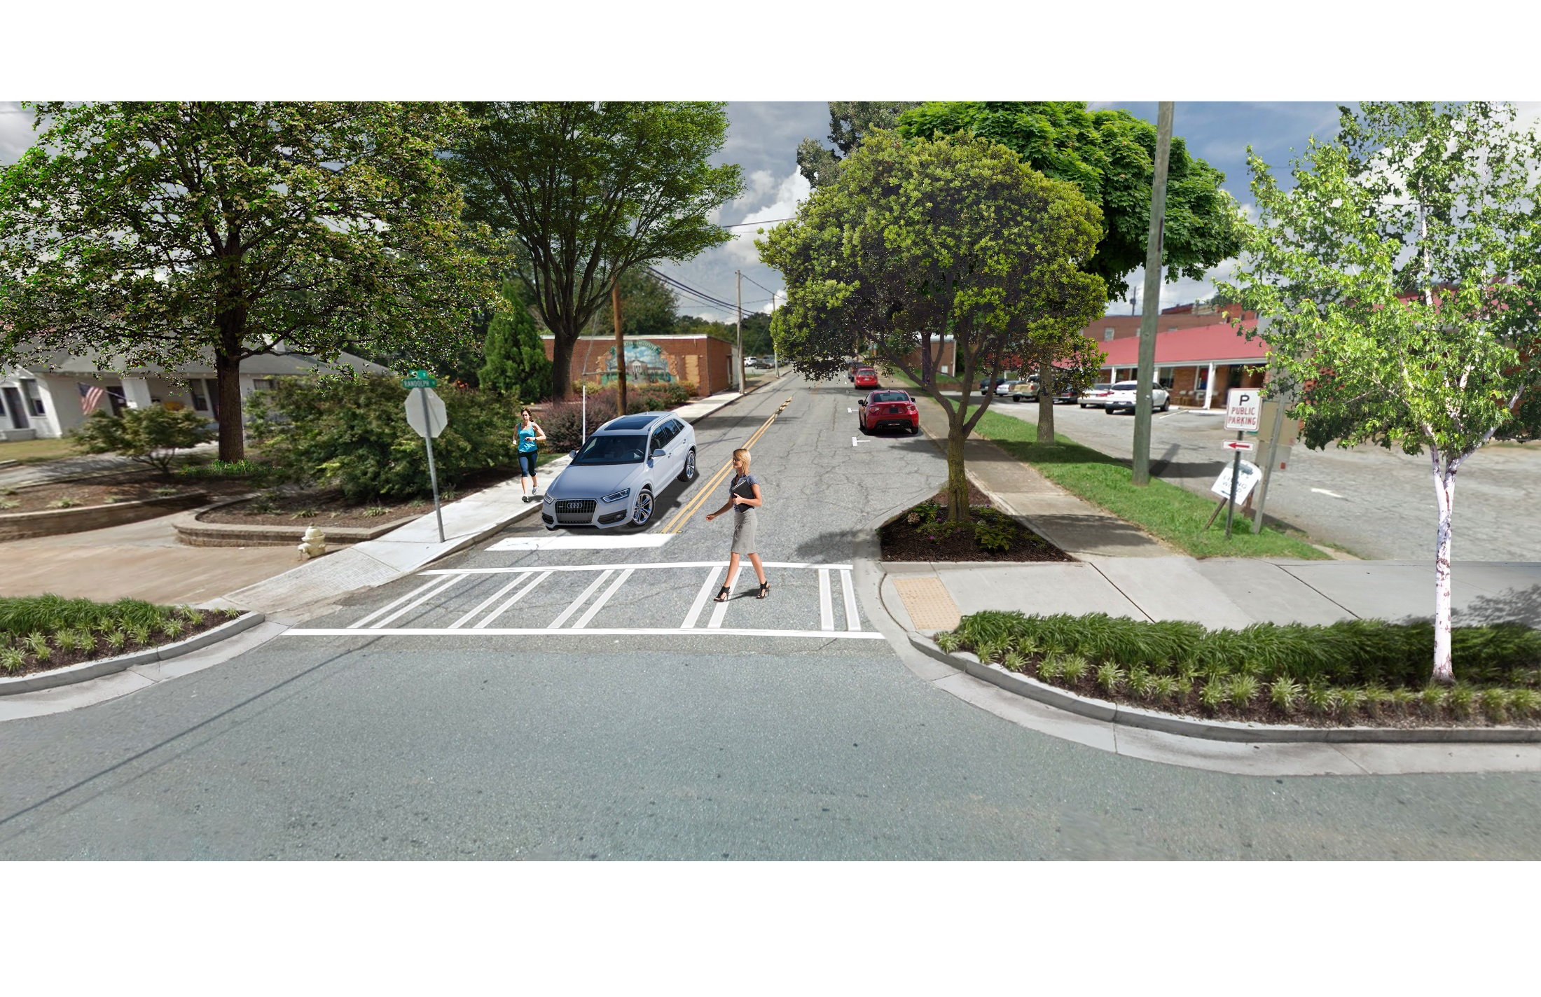
AFTER
Notes:
^{Randolph Street, After}
The addition of shade trees make for a pleasurable walking experience. A planted landscape buffer between the roadway and the sidewalks paired with bump-outs for trees beautify the street and provide a more pedestrian-friendly atmosphere.

Slide 55
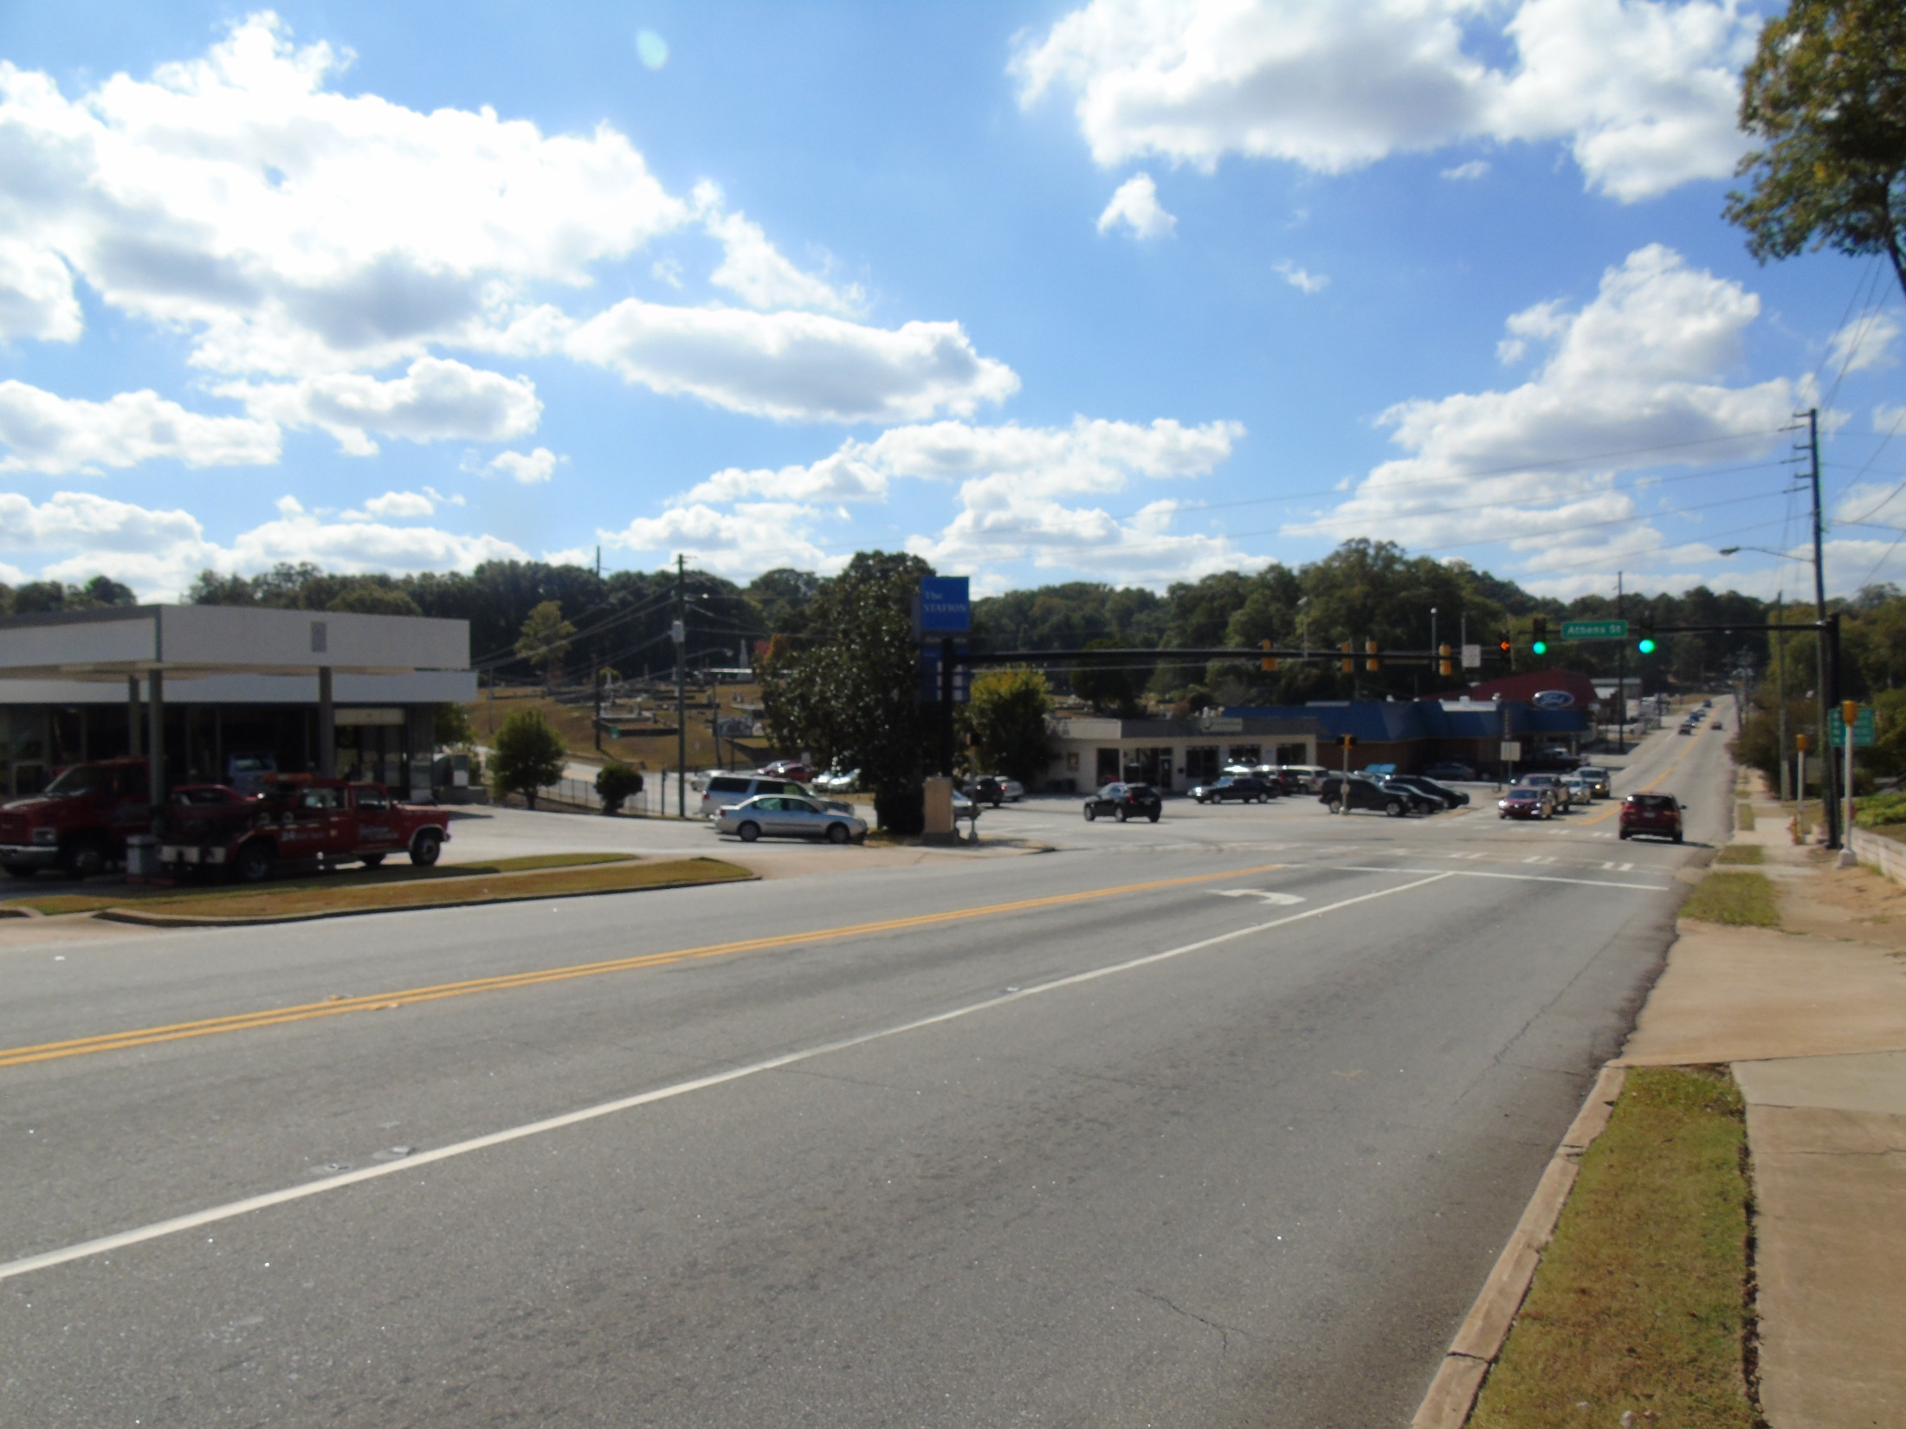
BEFORE
Notes:
^{Lee Street, Before}
This photo shows the same intersection from a half-block east looking away from downtown. The service station at the left has multiple curb cuts that could be used to improve the appearance of this busy corridor.

Slide 56
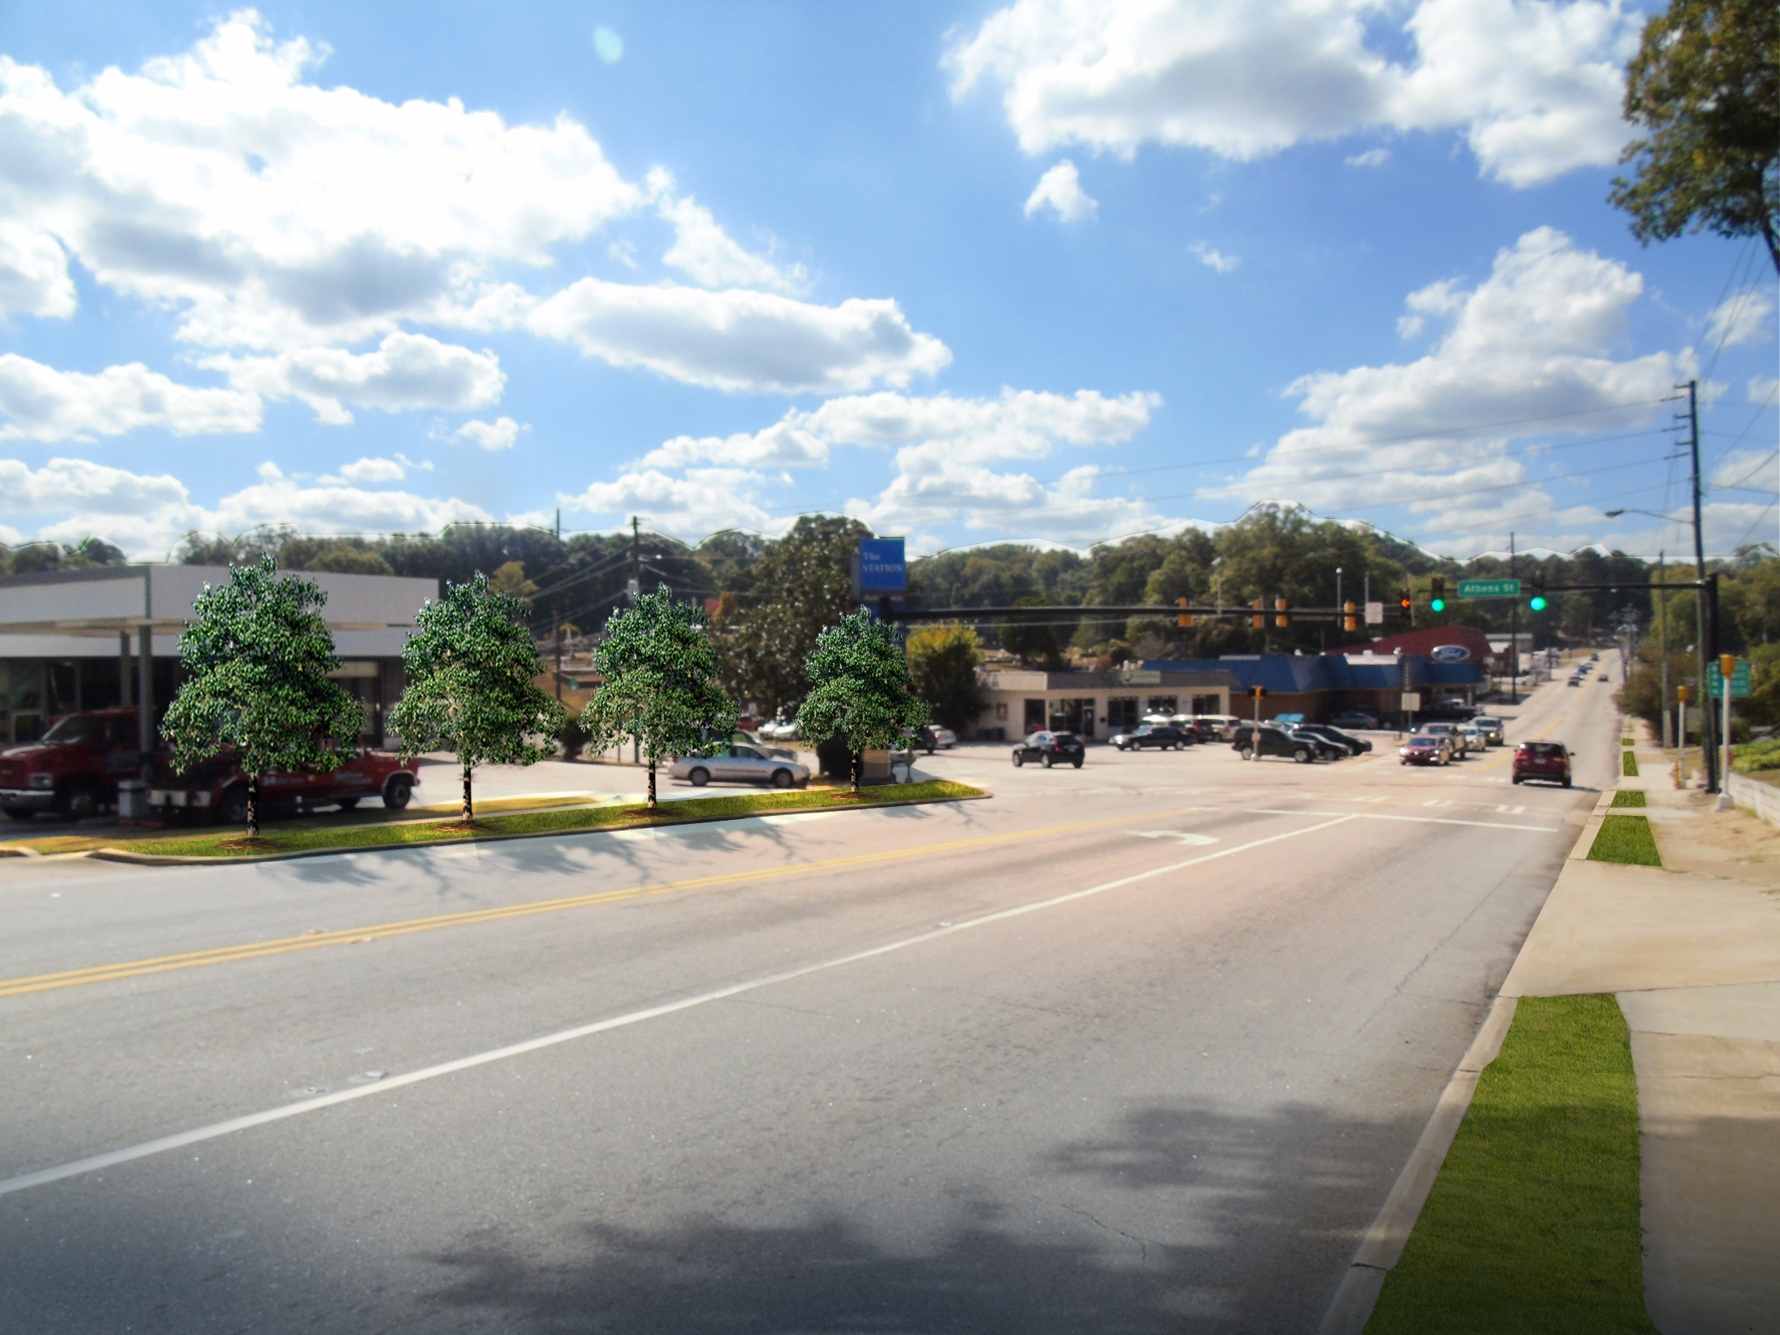
AFTER
Notes:
^{Lee Street, After}
This view of the same site shows a new landscaping strip that softens the harsh appearance of the corridor. The former curb cut now hosts street trees that offer shade for pedestrians and beautify this important gateway to downtown.

Slide 57
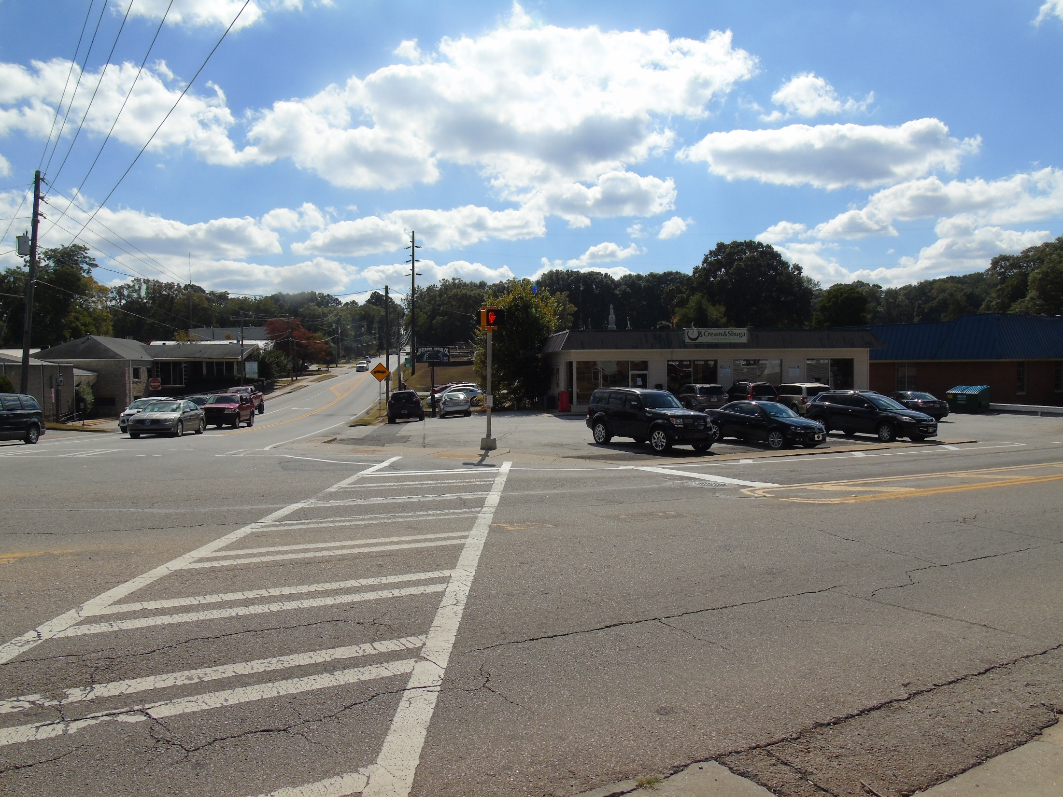
before
Notes:
^{Lee Street, Before}
Located at one of Jefferson’s busiest intersections just blocks from the heart of downtown, the current location of popular local café Cream & Shuga lacks the street trees and streetscaping improvements found along the square.

Slide 58
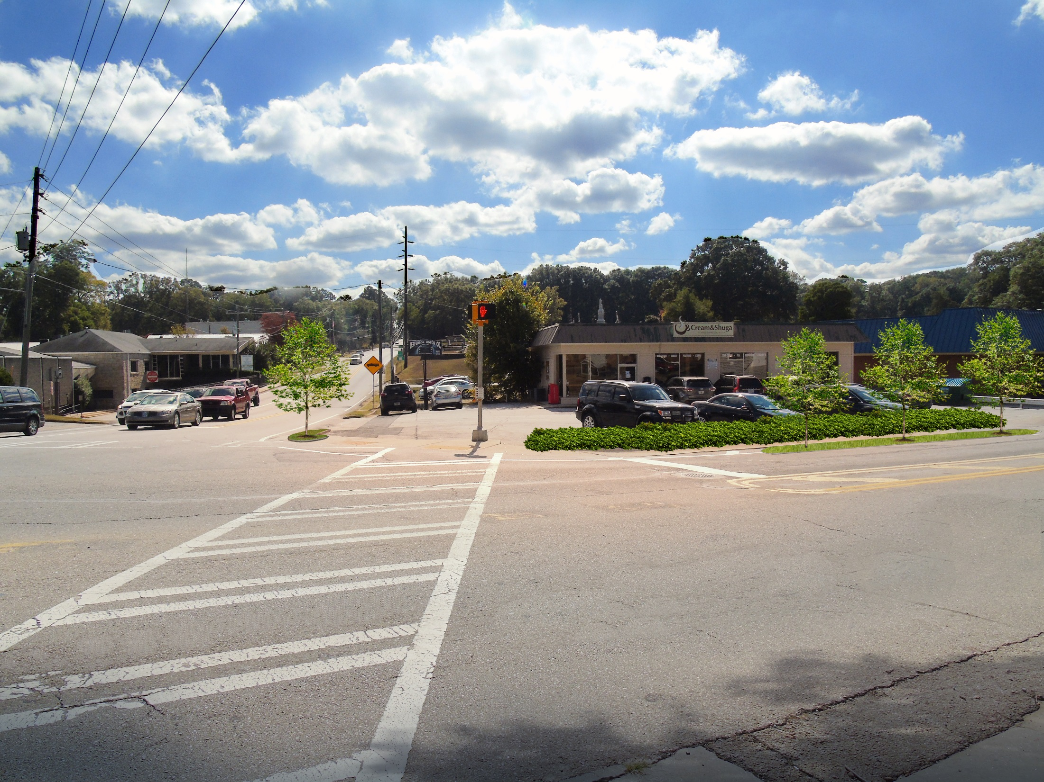
AFTER
Notes:
^{Lee Street, After}
With extended streetscaping improvements and newly installed landscape buffers, this important intersection now welcomes vehicular traffic and pedestrian activity downtown.

Slide 59
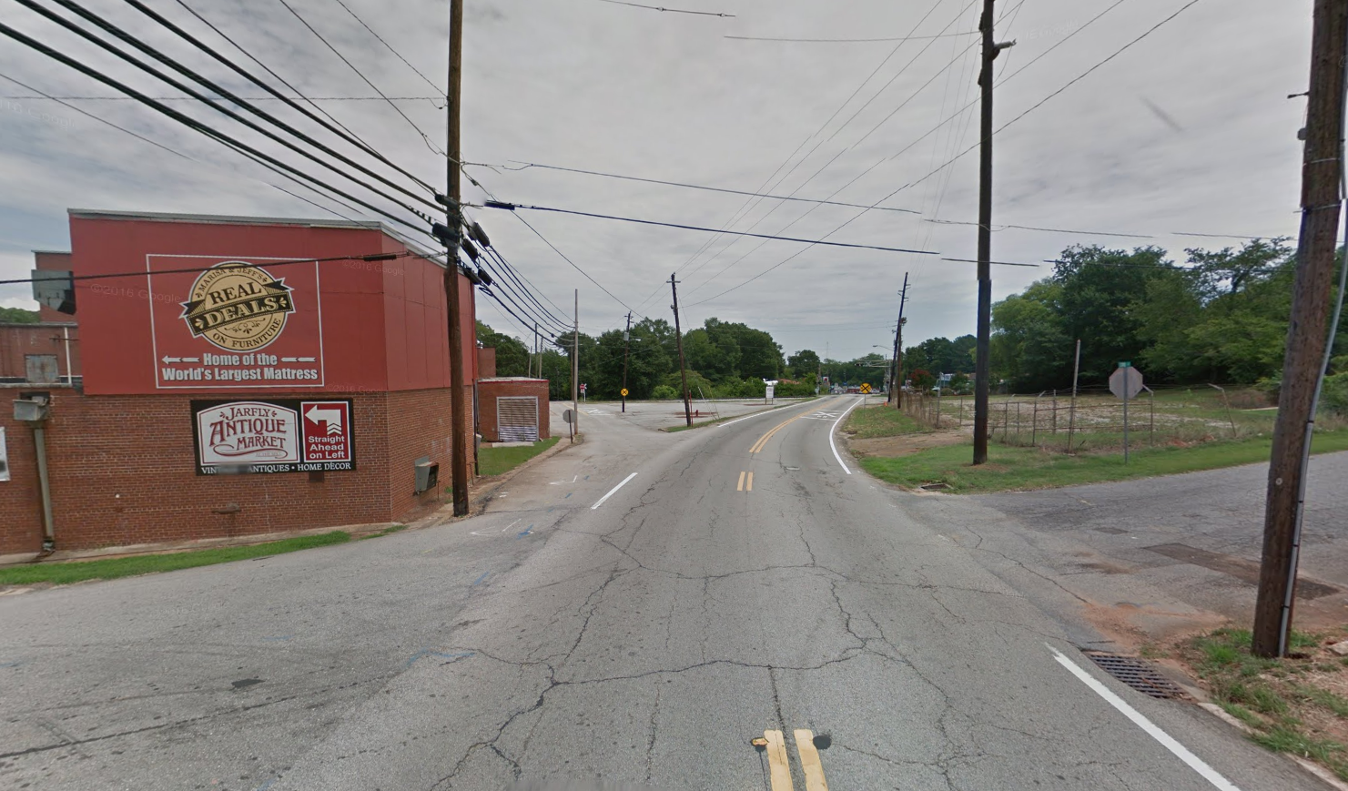
BEFORE
SHORT-TERM
Notes:
Real Deals Property Improvements, Before
Located along the busy Georgia 11–Lee Street corridor at the edge of downtown, Real Deals is a regional destination for furniture shopping. Currently, this corridor could benefit from landscape improvements and extended sidewalks and streetscaping from the downtown square.

Slide 60
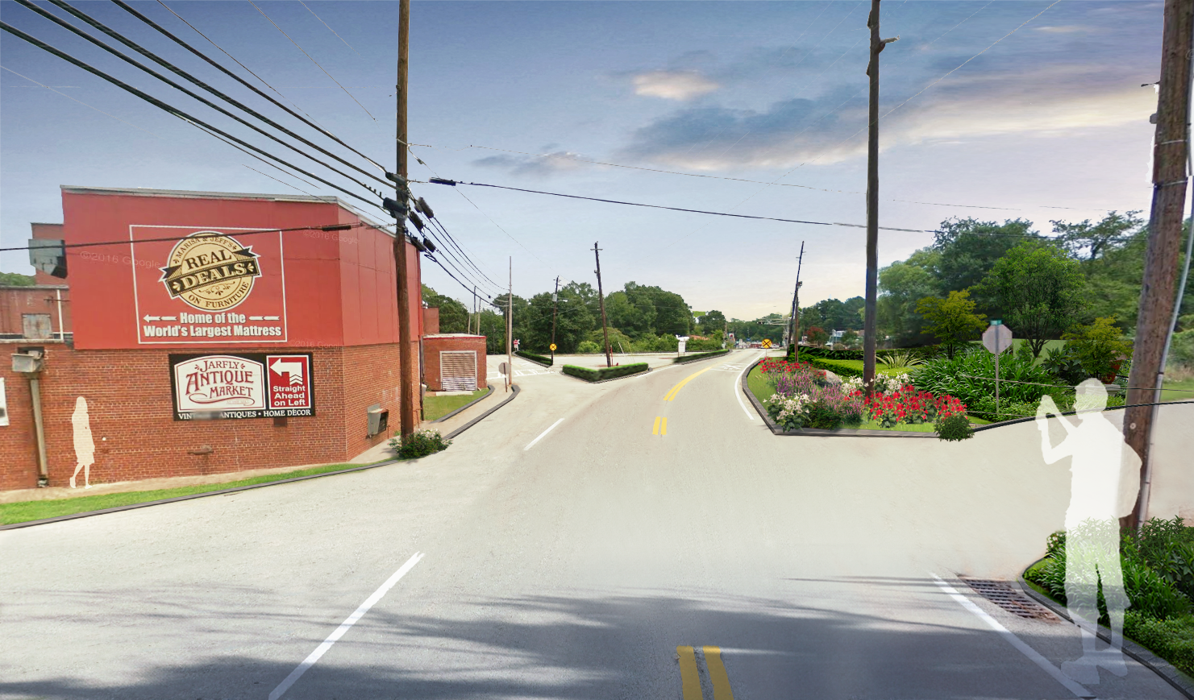
AFTER
SHORT-TERM
Notes:
Real Deals Property Improvements, Before
This “after” image shows the same view with the addition of sidewalks around the building, improved plantings in the large vacant area, new welcome signage, and new shrubs to buffer the existing triangle parking lot.

Slide 61
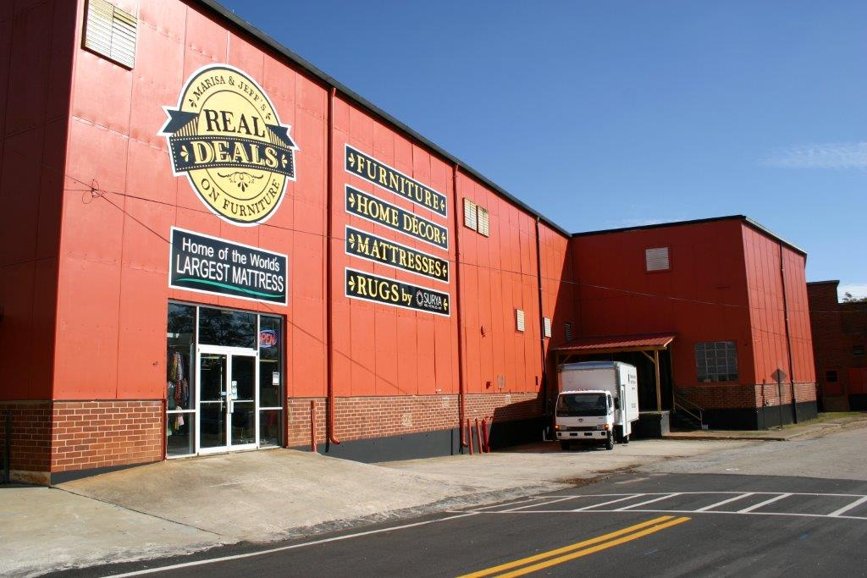
Economic Vitality

Slide 62
before
Notes:
McHaffey Street Infill (Cream & Shuga)
Before: The photograph above shows the former Jefferson Police Department located at the corner of Hill and McHaffey Streets.

Slide 63
After
Notes:
After: The rendering shows how the building can be adapted to house Cream & Shuga coffee shop, complete with exterior improvements such as landscaping, parking, and signage.

Slide 64
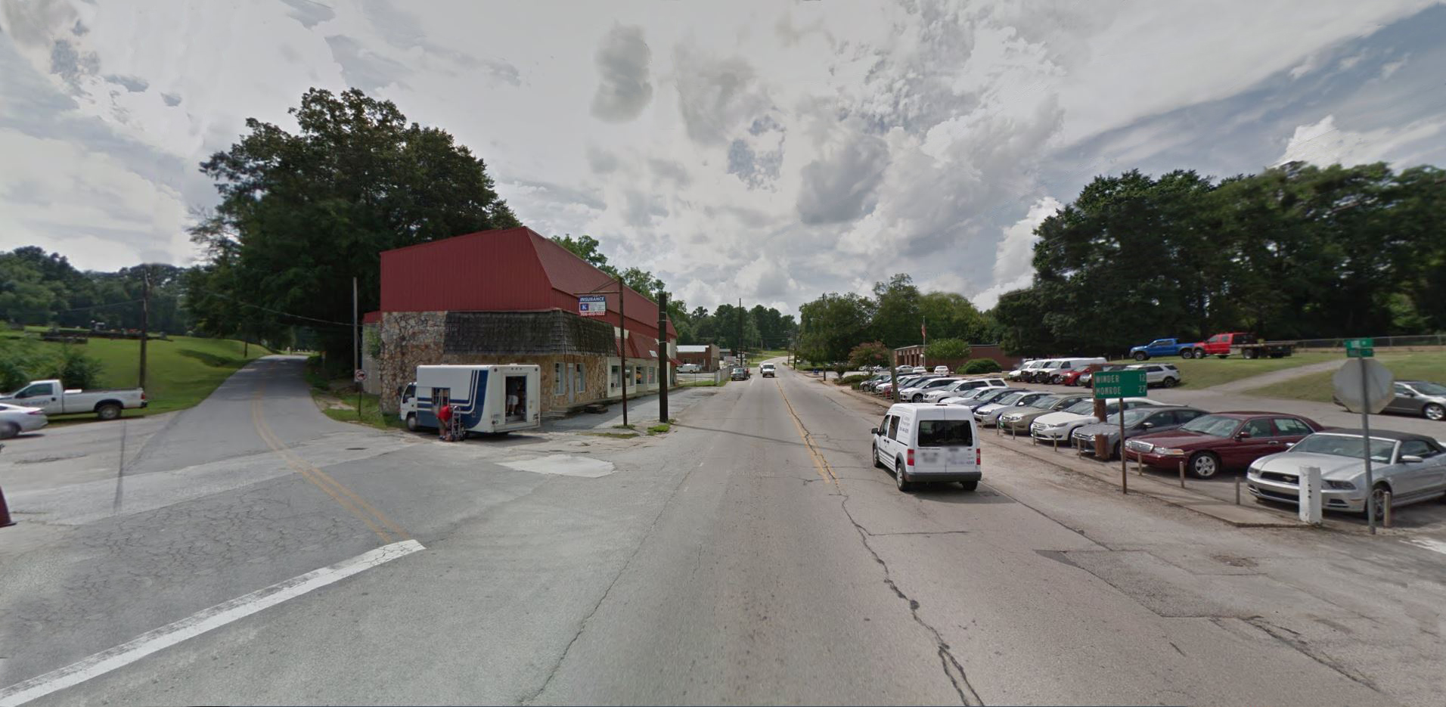
BEFORE
SHORT-TERM
Notes:
^{Lee Street Infill, Before}
This stretch of Lee Street adjacent to the sales lot of the Jefferson Motor Company illustrates the excessive widths of existing travel lanes and more than eight feet of excess, unused paved asphalt areas on either side of the thoroughfare. A meager sidewalk on the right side of the road does nothing to shield pedestrians from high-speed traffic and pedestrian activity just a few blocks from the heart of downtown. The former thrift shop on the left was often cited by public input participants as an eyesore.

Slide 65
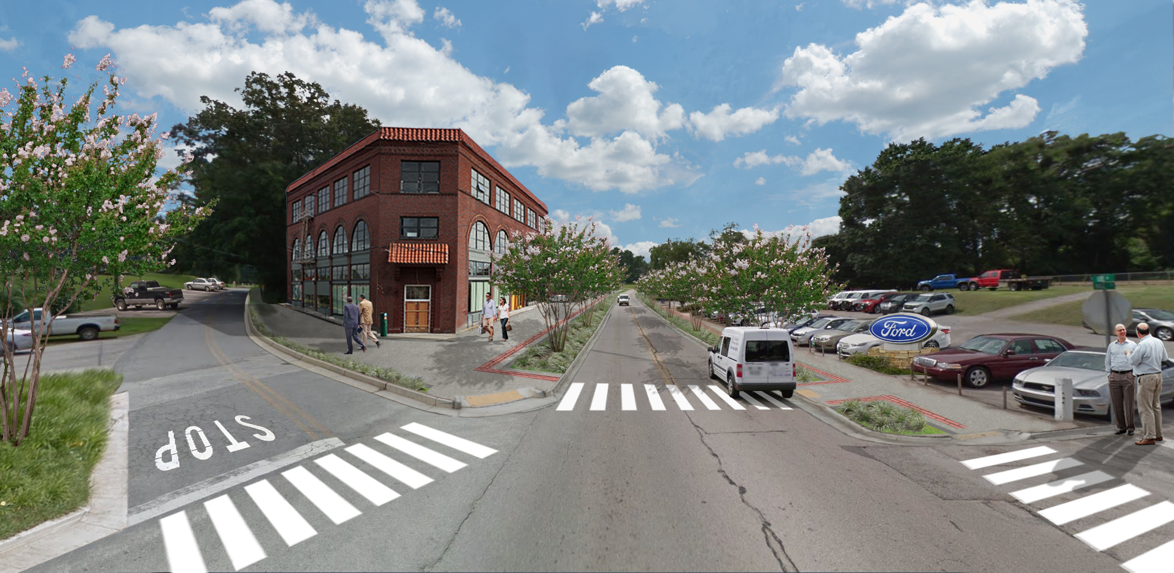
AFTER
SHORT-TERM
Notes:
^{Lee Street Infill, After}
This illustrative rendering shows the same view following the extension of streetscaping improvements along the square. Attractively landscaped bioswales designed to safely handle stormwater runoff now occupy the space of the formerly unused paved area. Natchez crape myrtles now line the busy corridor, providing shade and buffering pedestrians from vehicular traffic while preserving visibility of the adjacent sales lot. With a minimum width of ten feet, wide new sidewalks provide ample room for pedestrian and bicycle traffic while allowing for amenities like café seating. Traffic lanes along the corridor have been shrunk to improve safety for both pedestrians and drivers entering the busy downtown area, with clearly indicated crosswalks and signage. Reflecting demand and new standards for mixed-use buildings, the flat iron–style infill development to the left shows possible development opportunities along the corridor.

Slide 66
BEFORE
SHORT-TERM
Notes:
^{Former Hotel, Before}
Located on Lee Street, this building is home to Madella’s Clothing and Gifts and sits at a prominent corner downtown.

Slide 67
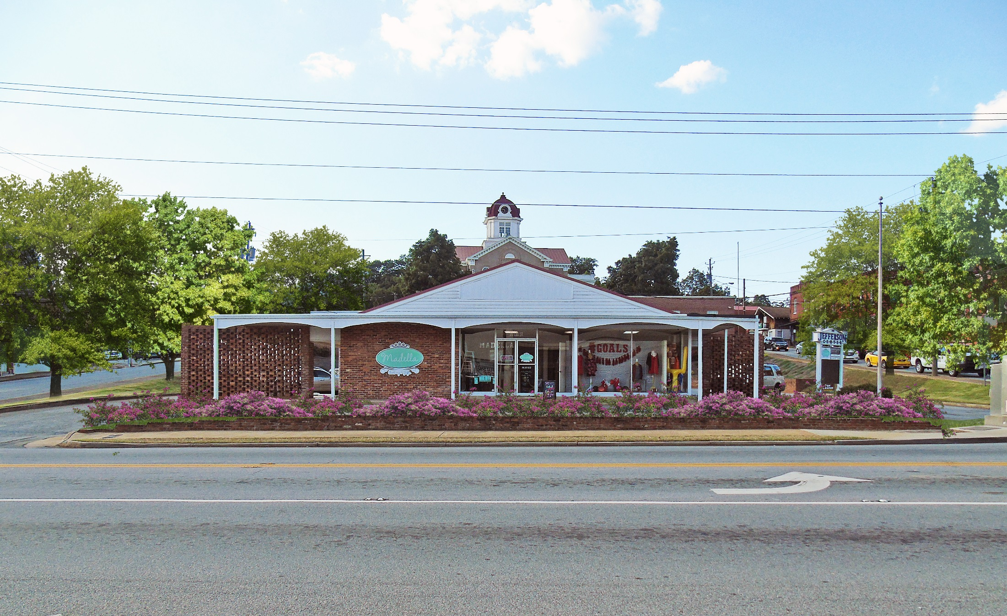
AFTER TREES AND FLOWERS
SHORT-TERM
Notes:
^{Former Hotel, After}
The following renderings show improvements in phases:
Phase 1: Willow oaks are planted along the property’s perimeter to improve the streetscape.
Phase 2: Flowers and low plantings are included along the brick wall in front of the business to improve curb appeal while not blocking business signage.

Slide 68
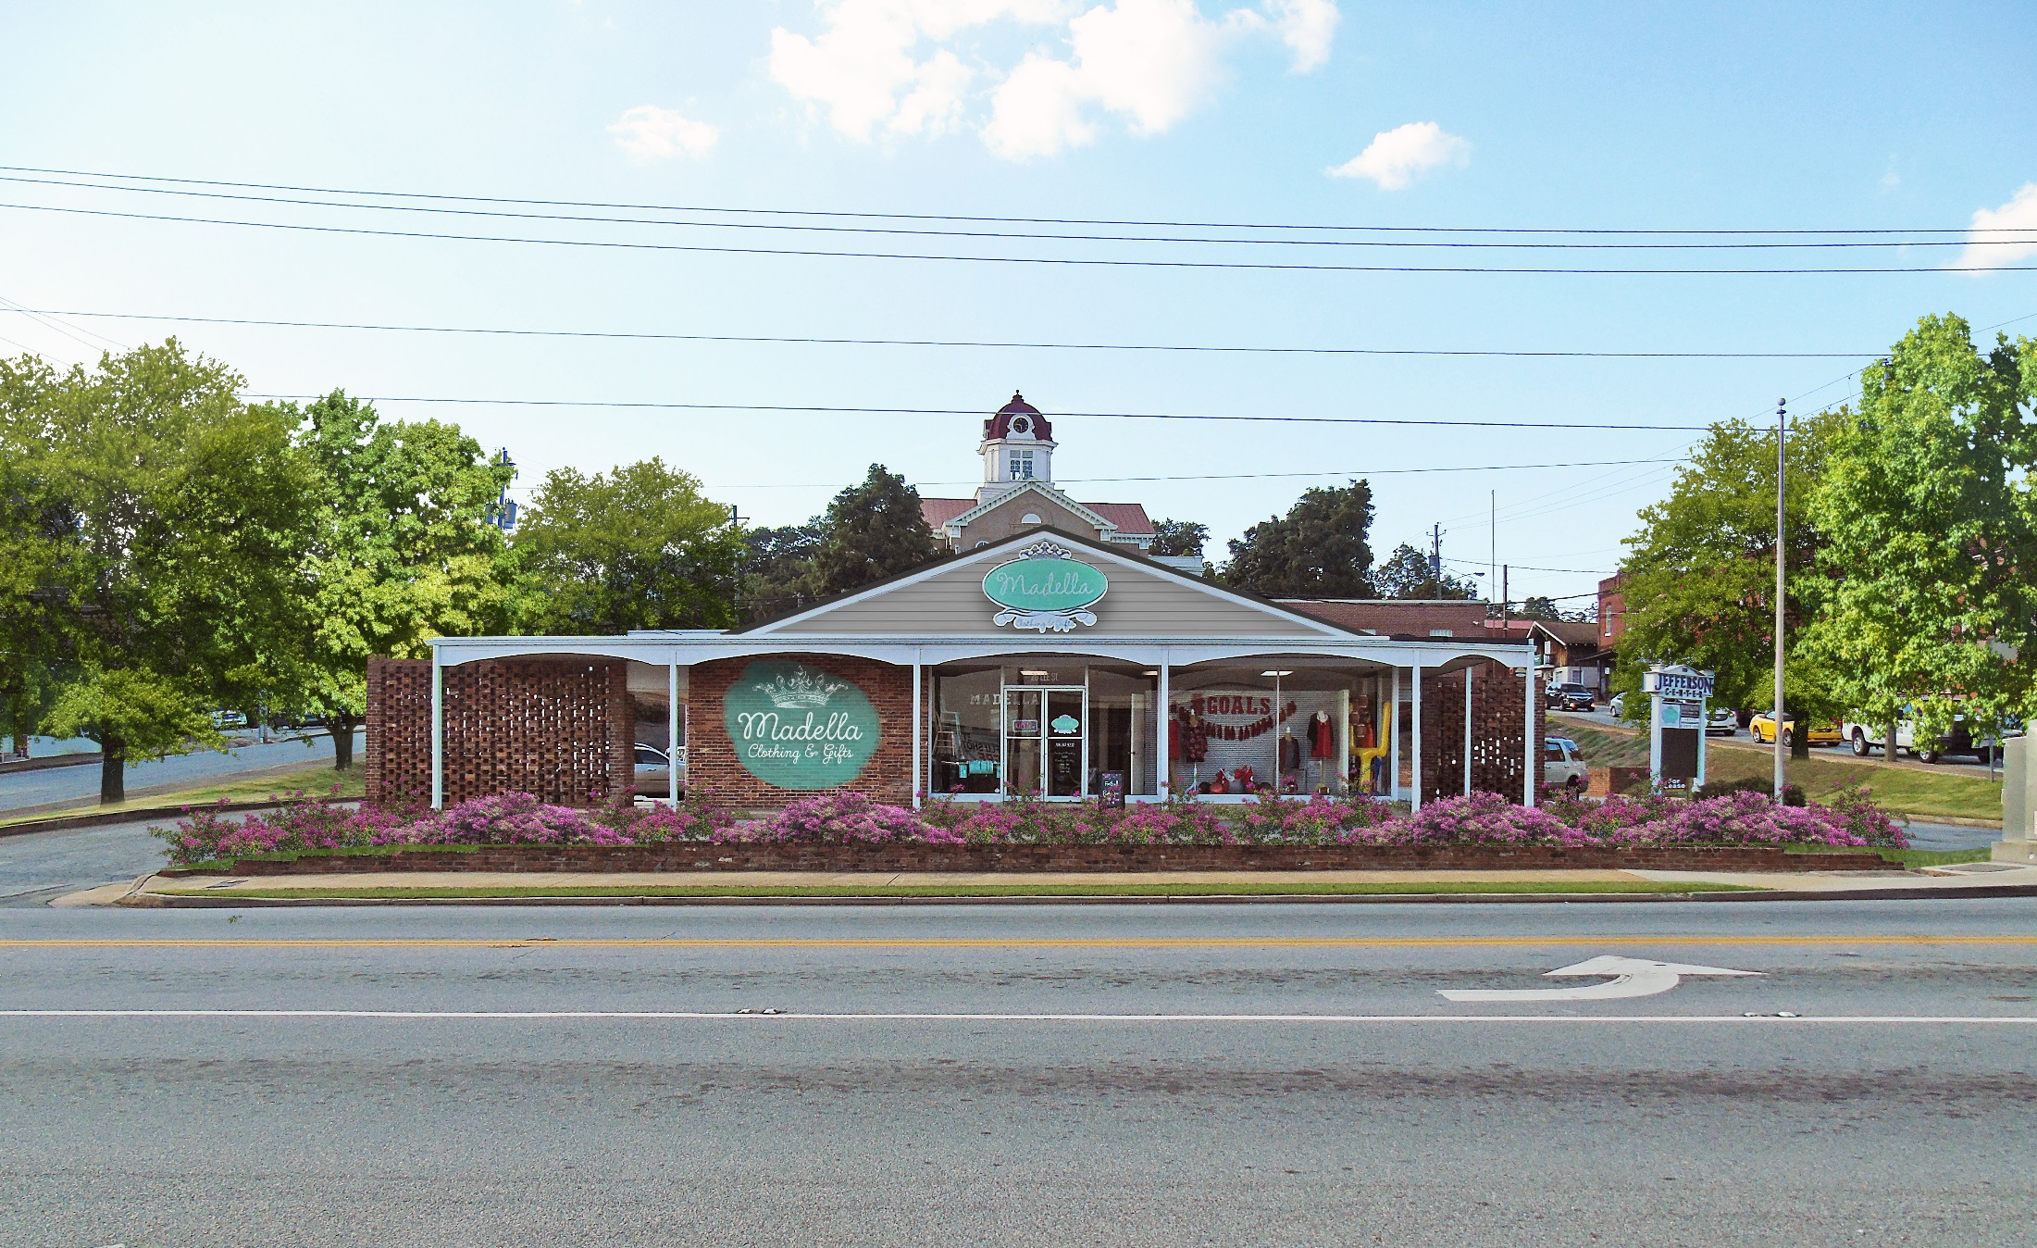
AFTER SIGNAGE & FAÇADE IMPROVEMENTS
SHORT-TERM
Notes:
Phase 3: The building’s façade is improved with paint and new signage.

Slide 69
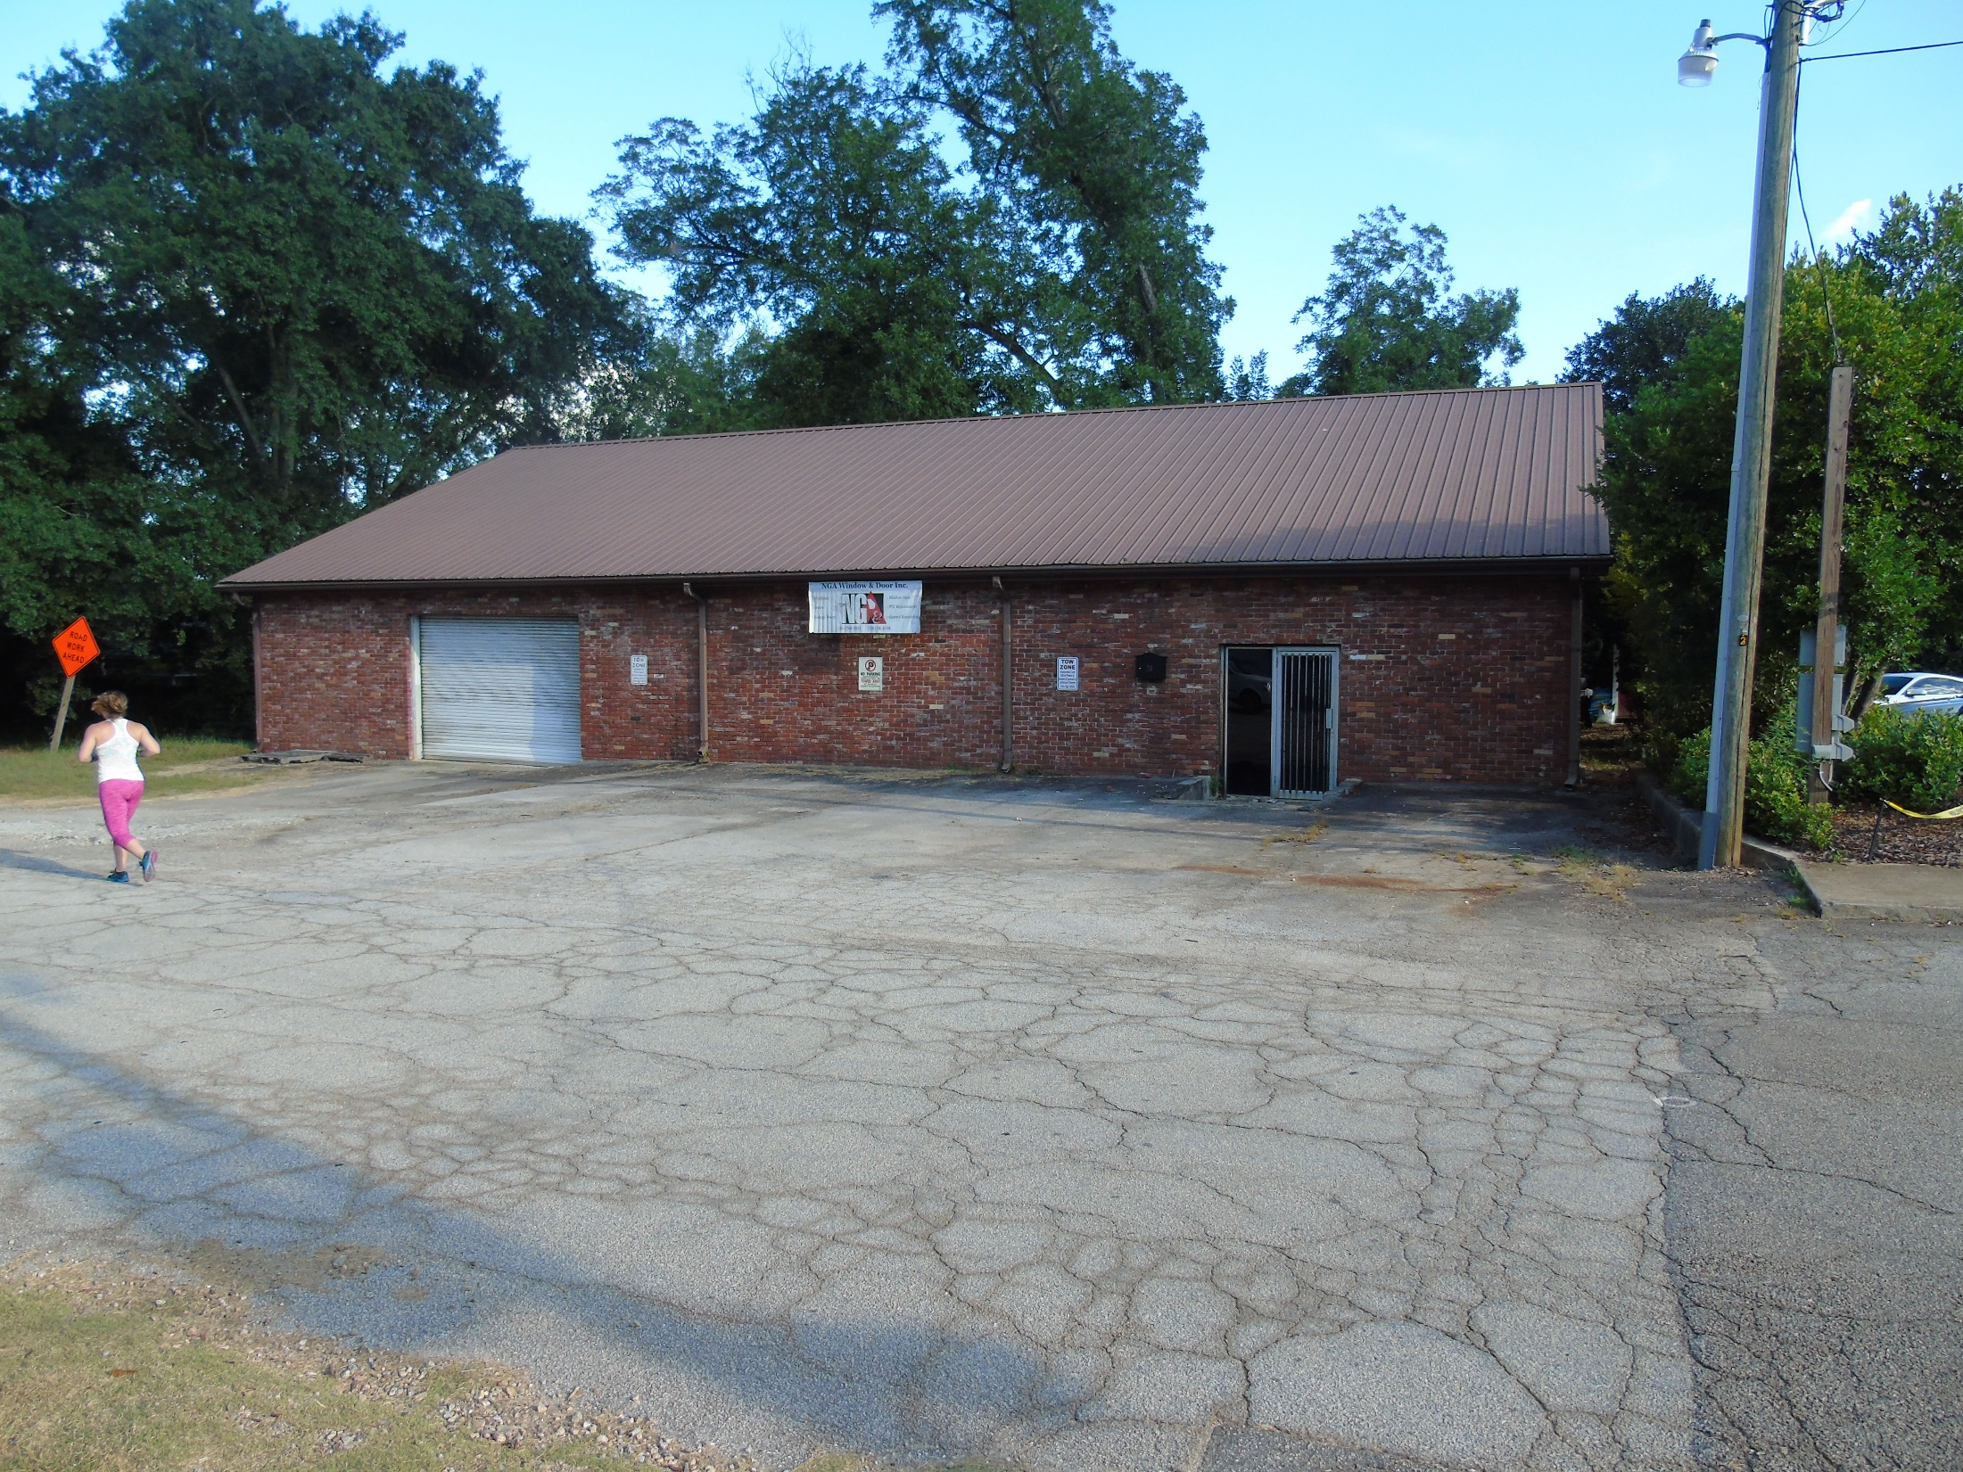
BEFORE
Notes:
^{Business Incubator, Before}
This vacant brick building is located on East Minden Street.

Slide 70
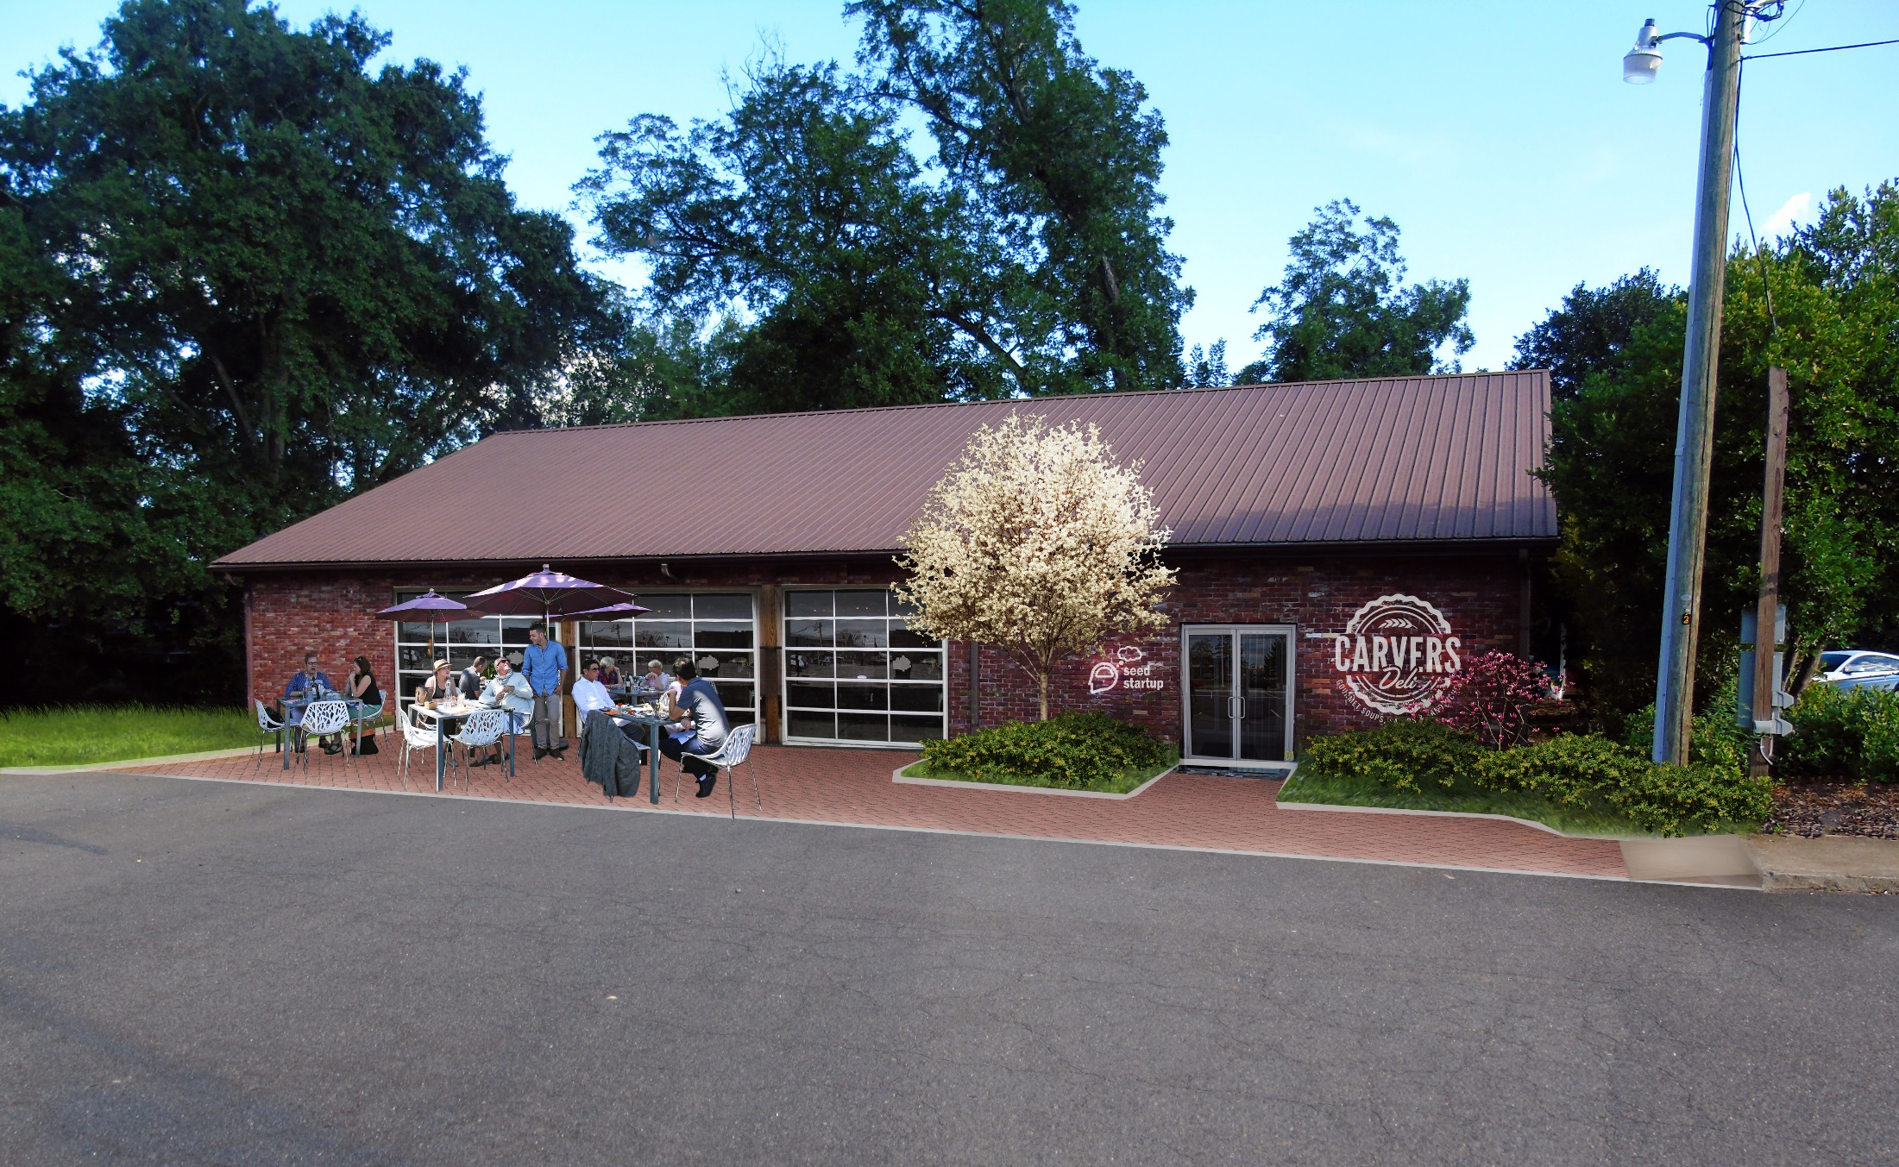
AFTER
SHORT-TERM
Notes:
^{Business Incubator, After}
The rendering shows exterior improvements to the building including new glass garage and entry doors, brick patio, café seating, and plantings. The need for a business incubator space was stated throughout the public input process, and this building could be used for that purpose.

Slide 71
GORDON ST. BACK OF BUILDINGS & INFILL SHORT-TERM
BEFORE

Slide 72
GORDON ST. BACK OF BUILDINGS & INFILL SHORT-TERM
AFTER

Slide 73
BEFORE

Slide 74
AFTER
Notes:
^{Amphitheater / Music Venue}
The rendering below shows what the new amphitheater could look like. Trees are planted on grass steps to provide shade and context-appropropriate mixed-use infill can be seen in the background.

Slide 75
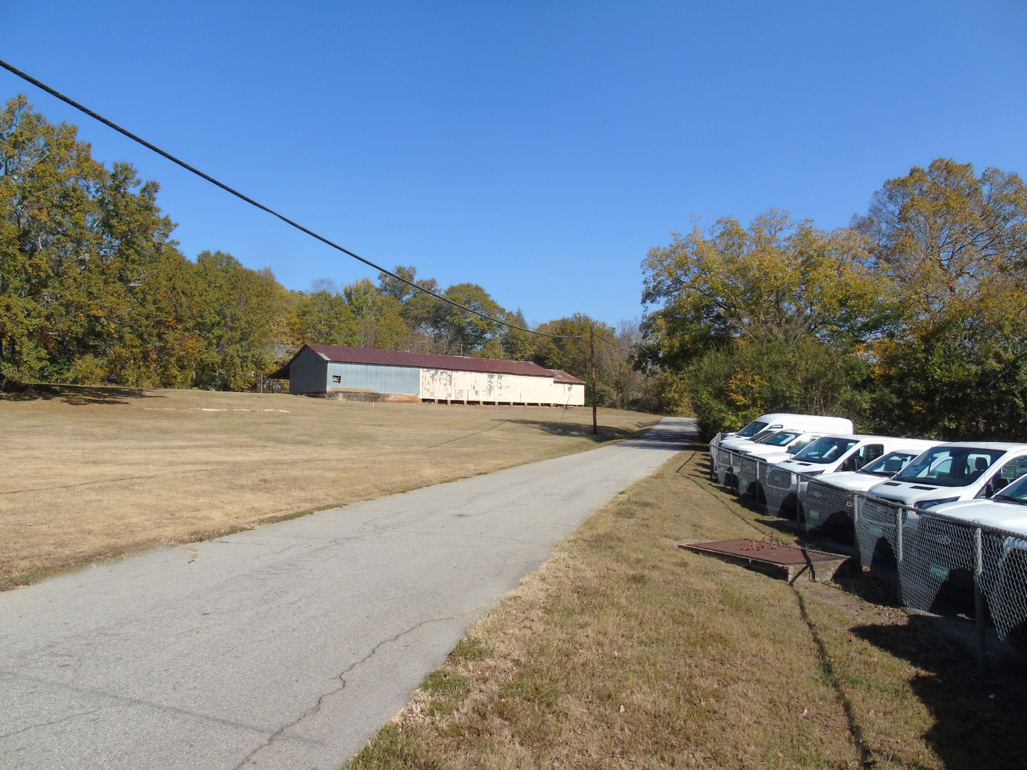
BEFORE
Notes:
Elm Street and Hill Street, opportunity for new infill residential development

Slide 76
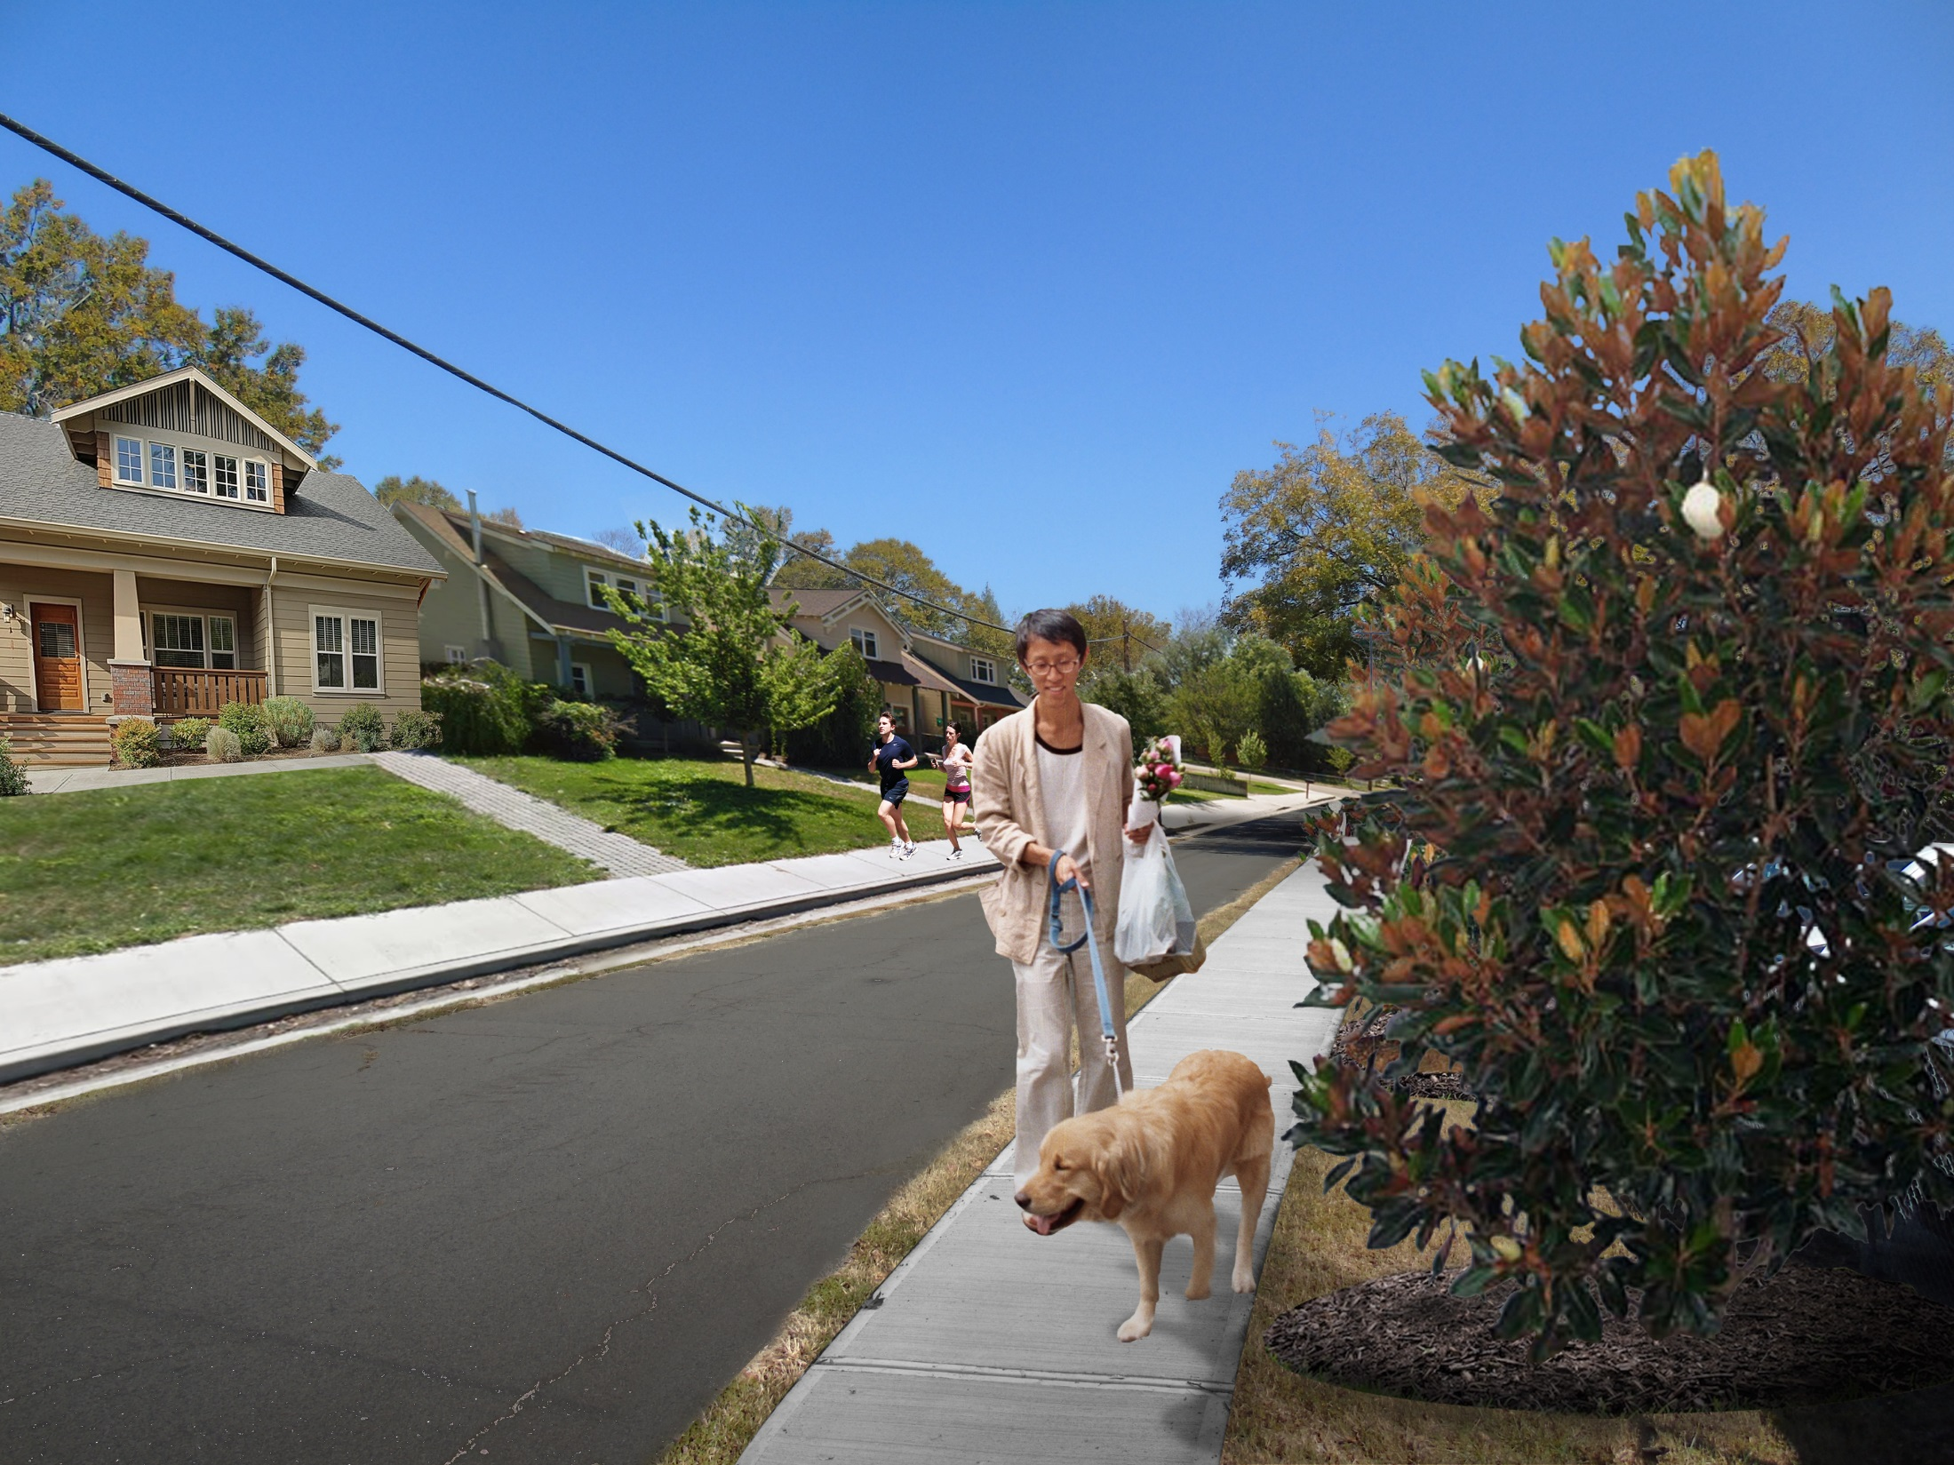
AFTER

Slide 78
ACTION ITEM FORM
1. Organization 2. Promotion 3. Design 4. Economic Vitality
Action Item (title): _Parking Audit_______________
Lead (1 person): __UGA________________________
Partners (who is really going to help): Beth Laughinghouse_____
Timeline (start-finish): ­­­­­­_August-September__
Funding (how much and where): part of the contract_______
Obstacles (stumbling blocks): ­­­­­­­N/A _________________________
Steps (what are you going to do when you leave this meeting):
1. Create a base map
2. Walk and count spaces
3. Transcribe on map public and private spaces
4. Have Beth review and edit map
5. Communicate results
6. Create another action item: Visitor Map with parking and businesses for downtown Central
Business District

Slide 79
ACTION ITEMS: ORGANIZATION
Short Term:
Downtown Wellness Walk
Create a Youth Main Street Program
Community Youth Clean Up
Theater Space in Civic Center

Slide 80
ACTION ITEMS: PROMOTION
ACTION ITEMS: PROMOTION
Short-term:
Local Lodging/Airbnb
Tourist Info Sheet
Create a Downtown Gift Card
Eventbrite Events
Short Term: Consolidate Online Presence
PTO Newsletter Weekly Calendar
Parking Signage (Behind Courthouse and Subway)
School Signage for Downtown Events

Slide 81
ACTION ITEMS: PROMOTION
Short Term: Planting Trees at Woodbine Cemetery
Short Term: Crosswalks behind Courthouse Parking
Short Term: Former Hotel Landscaping/Trees
Short Term: Initiate Public Art and Design
Long Term: Extend Sidewalks along Subway and Cakery

Slide 82
ACTION ITEMS: ECONOMIC VITALITY
ACTION ITEMS: ECONOMIC VITALITY
Short Term: Prohibit Storage in CBD
Long Term: Broadband Advisory Committee

